Slide 1
English language 2
31.3. 2022.

Slide 2
Table of content
The first part of the class
The second part – notes on the outline of an essay ( template – working on specific examples)
The third part – notes on Serbian

Slide 3
Integers can be thought of as discrete, equally spaced points on an infinitely long number line. In the above, non-negative integers are shown in purple and negative integers in red. Like the natural numbers, Z is closed under the operations of addition and multiplication, that is, the sum and product of any two integers is an integer. However, with the inclusion of the negative natural numbers, and, importantly, 0, Z (unlike the natural numbers) is also closed under subtraction. The integers form a unital ring which is the most basic one, in the following sense: for any unital ring, there is a unique ring homomorphism from the integers into this ring.

Slide 4
The first part: Integer
integer Any positive or negative counting number or zero.
Ceo broj, not intidzer!

Slide 5
The first part: Inverse (mathematical and mathematical context)
In mathematical contexts, the word ‘inverse’ is translated either as ‘inverzan’ or ‘suprotan’
(an inverse element, inverse function – inverzni element, inverzna funkcija)
In a physical context, we translate this as ‘inverzan’, inverse theory (inverzna teorija)
Inverzni Komptonov efekat
See explanations below:

Slide 6
The first part: Inverse (mathematical context): example: additive inverses
inverse 1. The additive inverse of a real or complex number a is the number which when added to a gives 0;the multiplicative inverse of a is the number which when multiplied with a gives 1.
Take inverse can act both as a noun and as an adjective.
Correspondingly, we translate it as: inverz, and inverzan
Additive inverse – aditivni inverz
However, there is a better wa to put it:
Inverz u odnosu na sabiranje

Slide 7
The first part: Inverse: mathematical context: some Serbians synonyms
We can both say: inverzni broj and also : suprotni broj

Slide 8
The first part: Inverse: Nonmathematical context inverse
The inverse compton radiation The radiation produced when a high energy (relativistic) electron interacts with a much slowermoving photon thereby transferring energy from the electron to the photon.

Slide 9
The first part: countably infinite: mathematical context
Serbian synonym: prebrojivi beskonacni skup (not: beskonacno prebrojiv!i)
A synonym: See denumerable set
denumerable set A set which may be put in one-to-one correspondence with the positive integers. Also known as countably infinite set.
The Serbian equivalent: prebrojivi skup, nondenumerable set: neprebrojivi skup
Examples of nondenumerable sets include the real, complex, irrational, and transcendental numbers

Slide 10
The first part: ring: mathematical and nonmathematical context.
We translate the word ring generally as ‘prsten’ whether we talk in a mathematical, astronomical or a chemical context
In an algebraic context, we can also translate it as ‘kolo’ (an older term)

Slide 11
The first part: Ring (an algebraic context)
1. An algebraic system with two operations called multiplication and addition; the system is a commutative group relative to addition, and multiplication is associative, and is distributive with respect to addition.
2. A ring of sets is a collectionof sets where the union and difference of any two members is also a member.
The simplest example of a ring is the collection of integers (…, −3, −2, −1, 0, 1, 2, 3, …) together with the ordinary operations of addition and multiplication

Slide 12
The first part: A difference between ‘group’ and ‘ring’: a mathematical context
The main difference between groups and rings is that rings have two binary operations (usually called addition and multiplication) instead of just one binary operation
If one forgets about multiplication, then a ring becomes a group with respect to addition (the identity is 0 and inverses are negatives). This group is always commutative!
If one forgets about addition, then a ring does not become a group with respect to multiplication

Slide 13
The first partl: Ring ( chemical context)
In chemistry, a ring is an ambiguous term referring either to a simple cycle of atoms and bonds in a molecule or to a connected set of atoms and bonds in which every atom and bond is a member of a cycle (also called a ring system)

Slide 14
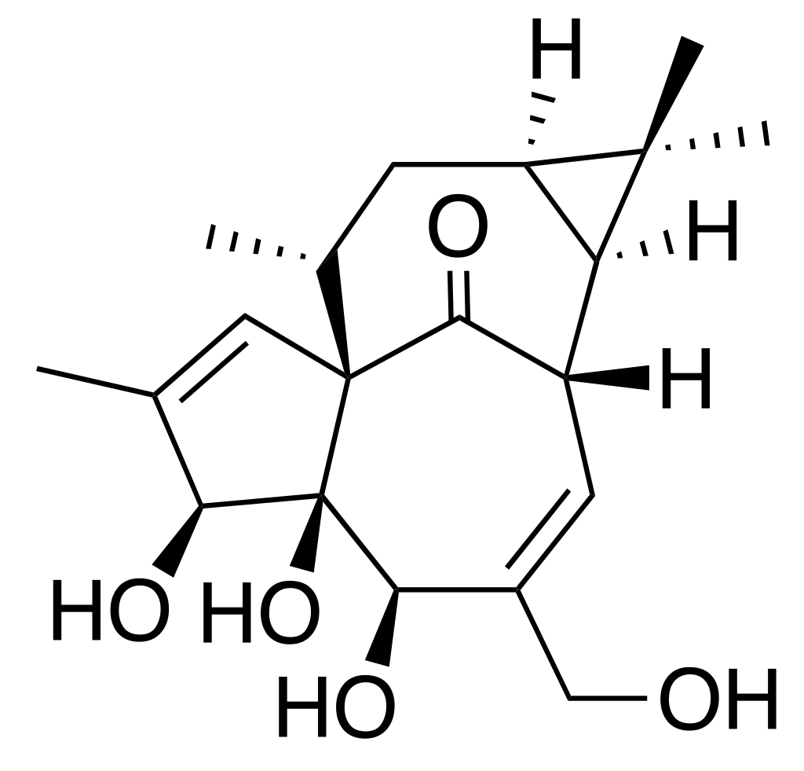
The first part: Ring – a chemical context (image)

Slide 15
The first part: ring (astronomical context)
Rings of small icy debris orbit around each of the four Jovian planets. The rings around Jupiter, Uranus, and Neptune are composed of very small particles (generally only a few microns in diameter) while the major rings of Saturn contain ice particles ranging in size from dust to boulders a few meters in diameter

Slide 16
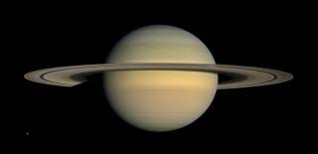
The first part: ring- Saturn: astronomical context

Slide 17
The first part: unitary ring (a strictly mathematical context)
In algebra, a unit of a ring is an invertible element for the multiplication of the ring.
The Serbian equivalent: unitarni prsten

Slide 18
The first part: A difference between ring, group and monoid: (exclusively mathematical context)
Consider the usual "axioms" of a group. the ingredients are a set S, and a function ⋅:S×S→S, which we write using infix notation (so we write a⋅b or ab instead of ⋅(a,b)). Then we require:
Associativity. ⋅ is associative: a(bc)=(ab)c for all a,b,c∈S.
Existence of neutral element. There exists an element e∈S such that for all a∈S, ae=ea=a.
Existence of inverses. For each a∈S there exists b∈S such that ab=ba=e, where e is a neutral element as in 2.
If we relax the requirements that all three conditions get satisfied, we get more general structures (but the more general the structure, the less we can say about them).

Slide 19
The first part: A difference between ring, group and monoid
If you drop all three conditions, you get a magma.
If you drop the second and third condition but keep the first, requiring only that the operation be associative, you get a semigroup.
If you drop the third condition but keep the first and second, requiring that the operation be associative and that there be a neutral element, you get a monoid.
If you keep all three conditions, you get a group

Slide 20
The first part: Abelian group” mathematical context
Abelian group A group whose binary operation is commutative;that is, ab is ba for each a and b in the group. Also known as commutative group
A Serbian equivalent: Abelian group – Abelova grupa (not: abelovska!)

Slide 21
The first part: Cyclic group: mathematical and chemical context: mathematical context
cyclic group (mathematical context) A group that has an element a such that any element in the group can be expressed in the form an, where n is an integer.
Example. (The integers and the integers mod n are cyclic) Show that Z and Zn for n > 0 are cyclic

Slide 22
The first part: Cyclic group: an example (mathematical context)
1 + 1 = 2
1 + 1 + 1 = 3
1 + 1 + 1 + 1 = 4
1 + 1 + 1 + 1 + 1 = 5
1 + 1 + 1 + 1 + 1 + 1 = 6
1 + 1 + 1 + 1 + 1 + 1 + 1 = 0
In other words, if you add 1 to itself repeatedly, you eventually cycle back to 0.

Slide 23
The first part: Closure
Two meanings of closure:
The first meaning:
The union of a set and its cluster points; the smallest closed set containing
The second meaning:
Property of a mathematical set such that a specified mathematical operation that is applied to elements of the set produces only elements of the same set
A Serbian equivalent: klozura

Slide 24
The first part part: Cyclic group – chemistry: non-mathematical context
Chemical compounds arranged in the form of a ring or a closed chain form. cycloalkanes

Slide 25
The first part: The following concepts are exclusive used in mathematical contexts
Euclidean division
Euclidean algorithm
Disjoint union
Noetheirian valuational ring
Singleton set

Slide 26
The first part: Euclidean division
In arithmetic, Euclidean division – or division with remainder – is the process of dividing one integer (the dividend) by another (the divisor), in a way that produces a quotient and a remainder smaller than the divisor.

Slide 27
The first part: Euclidean algorithm
Euclidean algorithm A method of finding the greatest common divisor of a pair of integers.

Slide 28
ordered ring
Rings which have an ordering on them as sets in a manner analogous orthogonal family to the behavior of the usual ordering of the real numbers relative to addition and multiplication
A Serbian equivalent: uredjeni prsten

Slide 29
Noetherian valuational ring
Noetherian ring A ring is Noetherian on left ideals (or right ideals) if every ascending sequence of left ideals (or right ideals) has only a finite number of distinct members.

Slide 30
The first part: A commutative ring with unity
A Serbian equvalent: komutativni prsten sa jedinicom

Slide 31
singleton set
singleton A set that has only one element.
A Serbian equivalent: singelton
Better: jedinicni skup

Slide 32
To be embedded – embedding.
An injective homomorphism between two algebraic systems of the same type]
A Serbian equivalent:

Slide 33
ring homomorphism
homomorphism A function between two algebraic systems of the same type which preserves the algebraic operations.
A Serbian equivalent: prsten homomorfizma (not: [prsten homomorfizma)

Slide 34
The second part: outline – introduction
How your outline should look like – the first midterm test
Please remember – an outline is not the same thing as a whole essay!
Do not write an essay before writing an outline.

Slide 35
The second part: the essay outline
Last time we have worked on unpacking the burdens of proof
We will go now a step further
Once you clearly delineate your burdens of proof, you have to support each buden of proof with a specific example
Thus, the order is as follows: burdens of proof are to be consistent with your thesis statement, whereas specific examples are to be consistent with your burdens of proof
Remember: you will later develop burdens of proof into headlines and your examples into fully-fledged paragraphs. See

Slide 36
The Second part: Outline – burdens of proof
THE THESIS STATEMENT: The deaths of over one million Armenians in Turkey were due to a Turkish government policy of genocide.

Slide 37
The second part: The following is the fully fledged outline
Introduction and the thesis statement.
THE THESIS STATEMENT: The deaths of over one million Armenians in Turkey were due to a Turkish government policy of genocide.
The thesis obliges us to show how Turkish government policy committed genocide
The first headline: The Ottoman government abuses so called ‘security’ measures between 1915 and 1918 in order to perpetuate atrocities against . Armenians.
a. The government arrested hundreds of Armenian leaders in Istanbul (many of them intellectual figures rather than politicians) over April 24 and 25. April
b. Arrests, local deportations, and massacres occurred on a relatively small
scale into April 1915, when conflict erupted in the city of Van. (
c. The Telchir Law (the Temporary Law of Deportation) of May 1915 – removal of the Armenian forces in Syria

Slide 38
The second part: outline- examples The second headline: Massacres Were the Policy of at Least Segments of the Government
Massacres Were the Policy of at Least Segments of the Government
a. In Istanbul, the Ministry of the Interior (headed by Mehmet Tahkal) and the Ministry of War (led by Enver Pasha) directed provincial governors to undertake the deportations.
b. The duration of the events: more than three years: suggests that the central government did not step in to stop them
c Ultimately tens of thousands of civil servants, police, and military personnel became complicit once the deportations began killing hundreds of thousands of people. The second headline:

Slide 39
The second part: The third headline:The Goal Was the Elimination of the Armenian
People from Anatolia a. The government portrayed Armenians as ‘traitors’’ and as scapegoats for the problems of the society
b. The government sustained massive genocide in order to prevent the seccession of Anatolia
c. The Young Turk leaders considered the removal of not only the Armenians, but also Greeks and others.

Slide 40
The second part: the essay outline: commentary a)A precise formulation of the thesis statement:
b) vertical thinking and consistence: each headline contains the same key words as the thesis statement or its synonyms: government, (the government’s goal), massacre, atrocities,
c) the specification of examples:
at least three examples are needed: each example answers at least one which question (the example from the first headline to question where? Answers by stating: i0n the city of Van, and to the question: when?, it answers by the question: in the April 1915). Or who? The Young Turk leaders)
I would not tolerate underspecified examples

Slide 41
The third part: Serbian English translation: basic vocabulary and phrases
Notes on the homework 3. See the pdf file posted.
A
1. Ako je data funcija F(x)= 3x – Given a function F(x)= 3x) ( use here the indefinite article. Do not miss i).
2. Ako se uvedu oznake Let us introduce the notation. It is not necessary to translate it in a word-by-word manner: if we
3. Ako I samo ako – if and only if ( do not abbreviate to iff if the Serbian text does not explicitly state: AKKO

Slide 42
The third part: D
Da bi se ovaj problem prevazisao – in order to overcome this problem (not that problem)!
Dovoljno je – it suffices to (not: it is sufficient to)
Dovesti u vezu – bring into connection (not: to bring into a connection, or into the connection with).

Slide 43
The third part: K, I
K
Kao sto ce se videti – as we see in the following examples, as it is to be seen/observed/inferred
Kvadratna funkcija – quadratic function (Not: quadric function!)
I
Iz definicije sledi – it follows from the definition, the definition implies

Slide 44
The third part: J, N
jednostavnosti radi ( or radi jednostavnosti) - for simplicity’ s sake,(or you can even write: for brevity’s sake).
N
Navedene – mentioned (or above mentioned
Neprekidna sa desna strane – continuous FROM the right side (take care: it is not: ON THE RIGHT SIDE, but: FROM THE RIGHT SIDE).

Slide 45
The third part: O
Odakle sledi da – whence it follows that (not whence follows: without ‘it’). We have discussed about the use of ‘hence’ to translate the phrase: odavde, odavde sledi. Apply the same rule to phrase: odakle sledi)
Compare:
Onda je F neprekidna, a odavde sledi na je ogranicena na D.
Then F is continuous, hence bounded on D.

Slide 46
The third part: P
Prekidna funkcija – discontinuous function

Slide 47
The third part: P
Posmatra: example: sada se posmatra – Now one considers - the phrase starting with ONE can be helpful in translating constructions containing a reflexive pronoun.
Polinom – polynomial (I will not accept: polynom). 1. Polynomials are continuous everywhere
Primedbe – remarks
Primedba ima za posledicu
The consequence of this remark is that

Slide 48
The third part: T
Tacka prekida – discontinuity
Tacke nagomilavanja - Points of accumulation
Teorema – theorem

Slide 49
The third part: U
Uociti –note, observe remark:
I recommend using the phrase: Note that

Slide 50
The third part: U
U ovom predavanju proucavaju se lokalna svojstva neprekidnih funkcija - this lecture studies local properties of continuous functions
Uvodi se pojam
This phrase is easily dealt with by using a passive construction:
Instead of saying: In this chapter, the concept of continuity is introduced,
This chapter introduces the concept of continuity

Slide 51
The third part:
O
Osim toga: Moreover (Not: besides. Do not google translate )
Otvoreni skup – open set

Slide 52
The third part: P
Po definiciji – by definition (not according to the definition)
Prirastaj – increment

Slide 53
T
Tezi ka nuli – approaches zero ( not: tends to zero). Also, take care bout the use of the present tense. It is approaches, not approaching (present continuous!) Is approaching zero would be a mistake!)

Slide 54
G Globalna svojstva – global properties
Izolovana tacka skupa – the isolated points of a set (take care about the use of the indefinite article: It is ANY SET in the text I have submitted and posted on Enastava. ).

