Slide 1
English language 2
Week 2 – 3. 3. 2022.

Slide 2
Table of contents
The first part: The lesson 1 – (rumyantseva’s textbook), vocabulary, mathematical, and nonmathematical context
The second part: Burdens of proof

Slide 3
Infinitesimal: the adjective- non-mathematical context
The meaning: extremely small – the infintesimal amount of happiness, the infinitismal amount of hope
Slight – small and not very important
Minor – not important enough
Infinitesimal – makes very little difference or is not worth worrying about

Slide 4
Infinitismal: the mathematical context
Infinitismal and infinitely small value are interchangeable

Slide 5
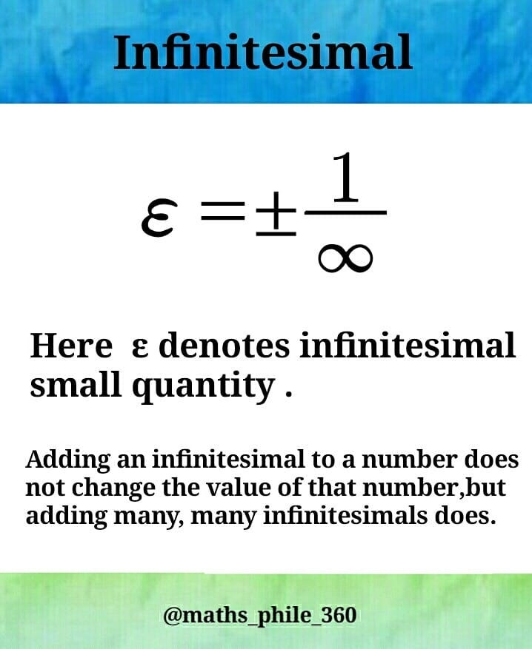
Infinitismal quantities

Slide 6
Infinitismal and indivisibles (a philosophical aspect)
The concept of an indivisible is closely allied to, but to be distinguished from, that of an infinitesimal. An indivisible is, by definition, something that cannot be divided, which is usually understood to mean that it has no proper parts. Now a partless, or indivisible entity does not necessarily have to be infinitesimal: souls, individual consciousnesses, and Leibnizian monads all supposedly lack parts but are surely not infinitesimal. But these have in common the feature of being unextended; extended entities such as lines, surfaces, and volumes prove a much richer source of “indivisibles”. Indeed, if the process of dividing such entities were to terminate, as the atomists maintained, it would necessarily issue in indivisibles of a qualitatively different nature. In the case of a straight line, such indivisibles would, plausibly, be points; in the case of a circle, straight lines; and in the case of a cylinder divided by sections parallel to its base, circles. In each case the indivisible in question is infinitesimal in the sense of possessing one fewer dimension than the figure from which it is generated. In the 16th and 17th centuries indivisibles in this sense were used in the calculation of areas and volumes of curvilinear figures, a surface or volume being thought of as a collection, or sum, of linear, or planar indivisibles respectively

Slide 7
Continuous function: a note on translation
We translate it as ‘neprekidna’ – not ‘kontinualna funkcija[! )

Slide 8
Continuous (nonmathematical contexts)
Continuous – continuing without stopping
Uninterrupted – continues for a long time without interruptions
Constant – constant and seems to be three all the time
On-going- will continue in future

Slide 9
Do not mix up continuous and constant function!
Constant functions are continuous everywhere. The identity function is continuous everywhere
All constant functions are continuous, but not all continuous functions are constant

Slide 10
The continuum and the infinitismal (a philosophical aspect)
In his Way of Truth Parmenides asserts that Being is homogeneous and continuous. However in asserting the continuity of Being Parmenides is likely no more than underscoring its essential unity. Parmenides seems to be claiming that Being is more than merely continuous—that it is, in fact, a single whole, indeed an indivisible whole. The single Parmenidean existent is a continuum without parts, at once a continuum and an atom. If Parmenides was a synechist, his absolute monism precluded his being at the same time a divisionist.

Slide 11
The continuum and the infinitismal (the second part)
Aristotle sometimes recognizes infinite divisibility—the property of being divisible into parts which can themselves be further divided, the process never terminating in an indivisible—as a consequenceof continuity as he characterizes the notion. But on occasion he takes the property of infinite divisibility as defining continuim

Slide 12
Another meanings of the word infinitismal
For engineers, an infinitesimal is a quantity so small that its square and all higher powers can be neglected. In the theory of limits the term “infinitesimal” is sometimes applied to any sequence whose limit is zero. An infinitesimal magnitude may be regarded as what remains after a continuum has been subjected to an exhaustive analysis, in other words, as a continuum “viewed in the small.

Slide 13
An infinitesimal number
An infinitesimal number is one which, while not coinciding with zero, is in some sense smaller than any finite number. This sense has often been taken to be the failure to satisfy the Principle of Archimedes, which amounts to saying that an infinitesimal number is one that, no matter how many times it is added to itself, the result remains less than any finite number.

Slide 14
Infinitesimal (a note)
This dubious entities were believed to have been finally supplanted in the foundations of analysis by the limit concept which took rigorous and final form in the latter half of the 19th century. By the beginning of the 20th century, the concept of infinitesimal had become, in analysis at least, a virtual “unconcept”.

Slide 15
A note on translation:
Infinitismal calculus – racun beskonacno malih or infinitizmalni racun
I suggest you to employ the first option
You are more likely to find the expression: infinitismal calculus in mathematical histories rather than in mathematical textbooks or monographies

Slide 16
Cavalieri principle: formulation
Two solids of the same height are such that their corresponding sections at any level have the same areas, then they have the same volume.

Slide 17
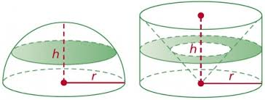
Cavalieri principle

Slide 18
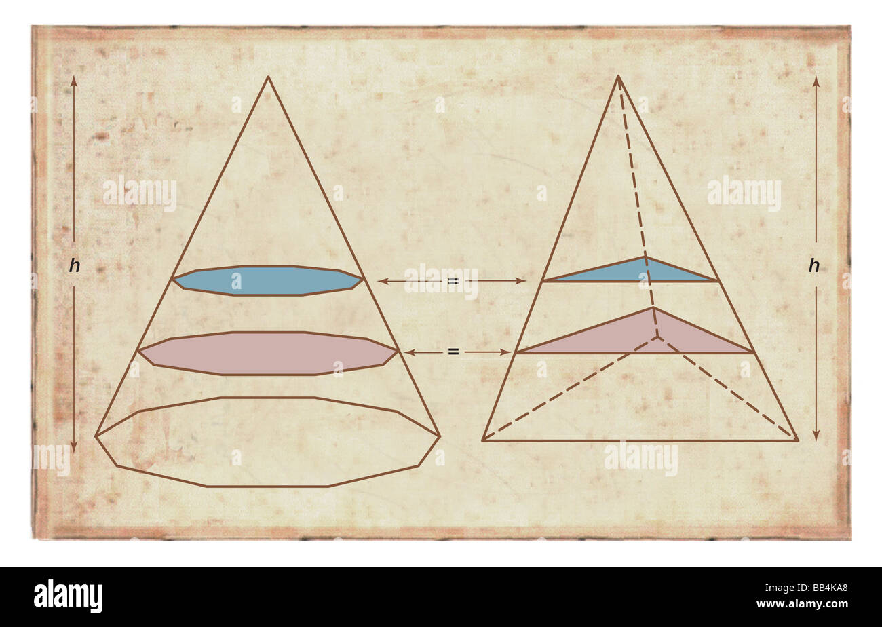
Cavalieri principle

Slide 19
Derivative – non-mathematical context:
Derivative- not original, but influenced by someone else’s work
The relatively new style of music is derivative of ragtime and blues

Slide 20
Derivative
derivative, in mathematics, the rate of change of a function with respect to a variable

Slide 21
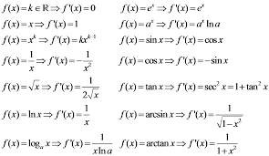
Derivative: basic rules

Slide 22
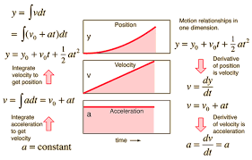
Derivative: physical context

Slide 23
Derivative: physical context
Derivative of position is velocity
Derivative of velocity is acceleration

Slide 24
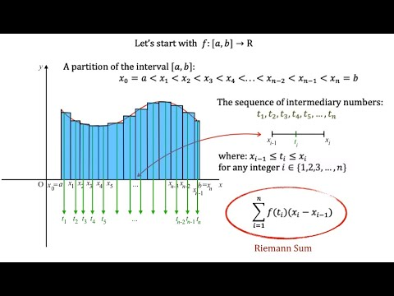
Riemman integral

Slide 25
Method of exhaustion – metoda iscrplivanja
The method of exhaustion does not require the infinite. The Eudoxian method of trapping the solution to a problem between a lesser and a greater approximation, for whichthe next step brings them closer, but the answer remains between is subtle and powerful and does not require infinitely small or large entities.
Archimedes was a master of such techniques.
They appear in Euclid's Elements.
Limits and sums come later.
Ranjan Roy's master work `Sources in the development of mathematics' is a wonderful source on the development of series notions in mathematics. Certainly series came much later

Slide 26
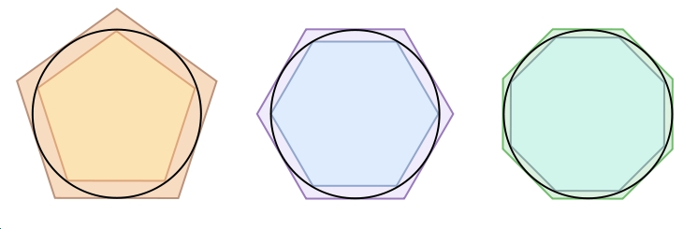
Method of exhaustion (images)

Slide 27
Method of exhaustion
Archimedes was trying to decompose a shape into the union of smaller and smaller shapes with pairwise disjoint interiors in order to compute the area of the original shape. This already involves sums (of areas of pieces) and limits (at each step we have a finite sum, but the sequence of these sums gets closer and closer to the number we are trying to determine.)

Slide 28
Power series – (stepeni redovi)
A power series is a type of series with terms involving a variable. More specifically, if the variable is x, then all the terms of the series involve powers of x. As a result, a power series can be thought of as an infinite polynomial. Power series are used to represent common functions and also to define new functions.

Slide 29
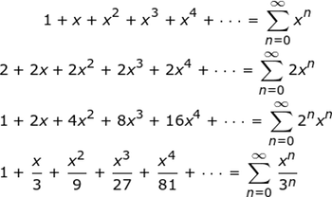
Power series examples

Slide 30
Discontinue – non mathematical context
Phase out – gradually end the use of a system or a service
Discontinue
The common point of meaning is: to stop providing something that has been regurarly provided over a long period of time

Slide 31
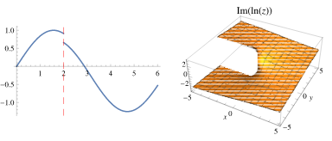
Discontinuities - a note on translation: prekid, tacke prekida: prekidne tacke:

Slide 32
A note on translation
Even though you may use both the terms: prekidne tacke I tacke prekida, I suggest to use: tacke prekida as a more natural option

Slide 33
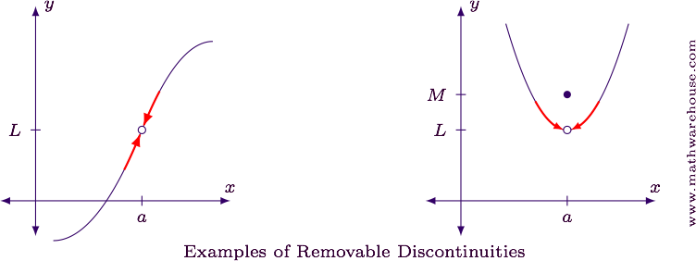
Examples of discontinuities

Slide 34
Endpoint Discontinuities
When a function is defined on an interval with a closed endpoint, the limit cannot exist at that endpoint. This is because the limit has to examine the function values as x approaches from both sides.
For example, consider finding limx→0x−−√ (see the graph below).
Note that x=0 is the left-endpoint of the functions domain: [0,∞), and the function is technically not continuous there because the limit doesn't exist (because x can't approach from both sides).
We should note that the function is right-hand continuous at x=0 which is why we don't see any jumps, or holes at the endpoit

Slide 35
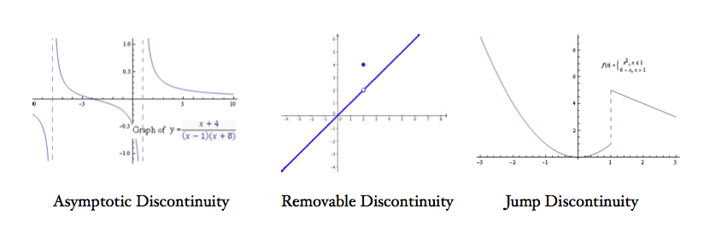
Other examples

Slide 36
Tacke prekida: Otklonjiv prekid
Removable Discontinuities can be Fixed
Removable discontinuities can be fixed by redefining the function, as shown in the following example.
Example
The function below has a removable discontinuity at x=2. Redefine the function so that it becomes continuous at x=2. f(x)=x2−2xx2−4
Solution
The graph of the function is shown below for reference.

Slide 37
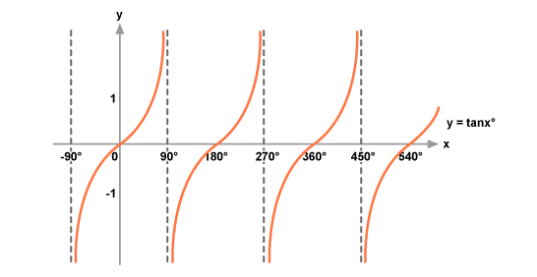
Tangent – discontinuous function:

Slide 38
Zeno’s paradox of dichotomy – formulation
Suppose a very fast runner—such as mythical Atalanta—needs to run for the bus. Clearly before she reaches the bus stop she must run half-way, as Aristotle says. There’s no problem there; supposing a constant motion it will take her 1/2 the time to run half-way there and 1/2 the time to run the rest of the way. Now she must also run half-way to the half-way point—i.e., a 1/4 of the total distance—before she reaches the half-way point, but again she is left with a finite number of finite lengths to run, and plenty of time to do it. And before she reaches 1/4 of the way she must reach 1/2 of 1/4=1/8 of the way; and before that a 1/16; and so on. There is no problem at any finite point in this series, but what if the halving is carried out infinitely many times? The resulting series contains no first distance to run, for any possible first distance could be divided in half, and hence would not be first after all. However it does contain a final distance, namely 1/2 of the way; and a penultimate distance, 1/4 of the way; and a third to last distance, 1/8 of the way; and so on. Thus the series of distances that Atalanta is required to run is: …, then 1/16 of the way, then 1/8 of the way, then 1/4 of the way, and finally 1/2 of the way

Slide 39
Zeno’s paradox of dichotomy (Zenonov paradoks dihotomije).
Well, every finite sum 1/2+1/4+1/8+...+1/2^n is equal to 1-1/2*n. (This is just a geometric sum.)
Since 1/2^n converges to 0 as n goes to infinity, the limit of this expression is equal to 1

Slide 40
Take care about the difference between difference between the phrases: differentiable and divisible
In mathematics, a differentiable function of one real variable is a function whose derivative exists at each point in its domain. In other words, the graph of a differentiable function has a non-vertical tangent line at each interior point in its domain.

Slide 41

Derivative
precise definition is to define the derivative as a limit of difference quotients of real numbers.[1]

Slide 42
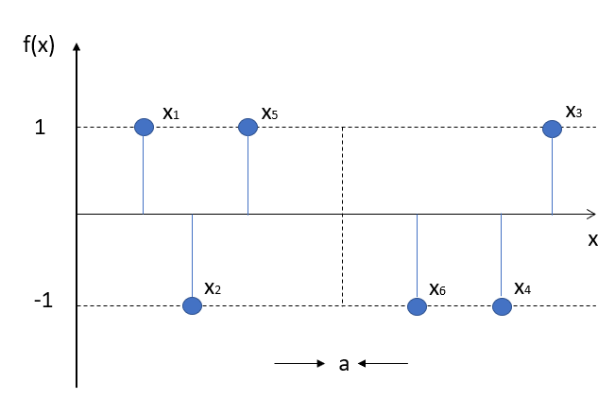
Nowhere continuous function: example: Funkcija koja nigde nije neprekidna (or: Funkcija koja nije neprekidna ni u jednoj tacki)

Slide 43
Phrases: continuous everywhere and nowhere discontinuous
The function sin(x) is continuous everywhere. The function cos(x) is continuous everywhere.

Slide 44
The Weierstrass function is an example of a real-valued function that is continuous everywhere but differentiable nowhere.
In mathematics, the Weierstrass function is an example of a real-valued function that is continuous everywhere but differentiable nowhere.

Slide 45
Note on translation (from English to Serbian).
It is better to translate the phrase as:
Funkcija koja nije neprekidna ni u jednoj tacnoj tacki,
Than: funkcija koja nijhe nigde neprekidna

Slide 46
Nowhere continuous function: examples
Dirichlet’s nowhere continuous function is a well-known nowhere continuous function, defined on ℝ (where ℝ is the set of real numbers): it equals 1 if x is a rational number (denoted by ℚ) and 0 is x isn’t a rational number. In notation (Chen & Smith), that’s: dirichlets function

Slide 47
Homework for 11. 3. 2021.
You are supposed to unpack your thesis statement and add burdens of proof
Informally, you have clearly to state what you are supposed to prove in order to support your thesis statement
Even though some people are able to frame their thesis statements properly, they are unable to form the burdens of proof
You are free to send me the burdens of proof for my feedback

Slide 48
The second part: FOUR TASKS TO MANAGE YOUR BURDENS OF PROOF (Muller, p. 79).
1. Identify the context, subject, and claim of the thesis statement.
2. Identify key terms or phrases that help defi ne the context, subject, or claim, such as:
● adjectives or adverbs
● superlatives (i.e., most, worst, best, always)
● specialized terms that require explanation
● terms or phrases that require background information
● introductory clauses or other key terms that limit the parameters of the argument
(i.e., today, twentieth century, regarding children, in my house)

Slide 49
Four tasks: continuation
2If you are unsure whether a term is “key” or not, remove the term or phrase and see if it changes the demands of the thesis statement or the direction or the boundaries of the argument. If so, then it is a key term and probably carries a burden of proof.
3. Examine the logical relationships within the thesis statement and identify whether there are any dependent points (or arguments) that must be made in advance of other points (or arguments).
4. Decide on the most effective order for covering the burdens of proof.Note: See appendix b for more specifi c examples of applying the four tasks to particular patterns of argument

Slide 50
EXAMPLE:
Couples who have children and want to divorce should be required by law to attend four months of couples counseling.
1. Identify the context, subject, and claim of the thesis statement.
Context: divorce in today’s society
Subject: couples who have children and are considering divorce
Claim: should be required by law to attend four months of counseling prior to divorce
2. Identify key terms or phrases that describe the context, subject, and claim.
Couples who have children and want to divorce should be required by law to attend four months of couples counseling.
3. Examine the logical relationships within the thesis statement and identify any dependent points.
4. Decide on the most effective order for covering the burdens of proof.

Slide 51
Unpacking burdens of proof
discuss how divorce is hard on children
● discuss how counseling can help families cope with divorce
● discuss why passing a law is the best way to achieve these goals
● discuss why four months of counseling is the right amount

Slide 52
Burdens of Proof and Logical Fallacies
Hasty Generalization and Overgeneralization
Avoid asserting a claim based on too little evidence. For instance, if you see two student
athletes cheat on exams and then offer the claim that all student athletes cheat on
exams, your statement would not be valid. No doubt there are many student athletes
who do not cheat on exams, so in using these two incidents to generalize for the whole,
you would be guilty of a hasty generalization. In other words, you would be judging
the whole by the part. Avoid using limitless terms such as all, every, always, and never
because they will often lead to overgeneralized or hasty claims; they suggest defi nitive
results that would be diffi cult—if not impossible—to substantiate.

Slide 53
Stereotypes
Stereotypes are a form of hasty generalization because they make assumptions about groups of people based on little or no evidence. If you argued, for instance, that women hate math; therefore math departments at women’s colleges are small, you would be basing your argument on a stereotype. There is no compelling proof that shows that all—or even most—women hate math, so this statement cannot be supported or proven. Furthermore, the cause/effect relationship suggested in this statement—that math departments are small because women hate math—cannot be developed logically because the assumption on which it is based (that women hate math) is unfounded (Cathleen Muller)

Slide 54
False Cause (Kathleen Muller)
A false cause defi nes a prior event as causal when it is not (also called post hoc, ergo
propter hoc, which means after this, therefore because of this). Just because one thing
happens before another does not necessarily mean that it has caused it. If, for example,
you broke a mirror in the morning and then failed a test later that day, false cause reasoning
would be concluding that breaking the mirror caused you to fail the test. If you
cannot link the cause to the effect through a valid chain of reasoning, then you may be
asserting a cause when there is coincidence only. This is a very common mistake withcause/effect that you should watch for carefully. Some other examples of false cause
errors include (1) arguing that because a new politician has taken offi ce, the immediate
reduction in crime or immediate increase in salaries can be directly attributable to his or
her election; (2) concluding that because the United States sent a new spacecraft to Mars,
the Russian economy has improved; and (3) deciding that lowering the legal bloodalcohol
level for driving has increased the sale of convertible cars. I

Slide 55
Non Sequitur (Kathleen Muller)
A non sequitur occurs when the logical connection between two or more items is not fi rmly established and an incorrect conclusion is drawn from the evidence. For example, you make the statement that your brother’s intense athletic training this summer will make him a good father. If your paper goes into great detail about the aspects of the athletic training but fails to make clear what this has to do with sound fatherhood skills,then the paper is guilty of a non sequitur. With revision, you might be able to establish a link between athletic training and fatherhood skills and thereby erase the non sequitur, but if this link is not fi rmly established (or cannot be fi rmly established), then the paper’s
claim is invalid.

Slide 56
Straw Man Argument
On the surface, a straw man argument is one that is so fl imsy that it is easily knocked
down. It is typically used in a self-serving context, as when you misrepresent an opponent’sargument by oversimplifying or exaggerating it, or by making assumptions for an argument that make it easy to refute. The fallacy arises because, with a straw-man argument,
the position you attribute to others is too reductive to be a fair representation of
the argument or something that few people, in reality, believe. For instance:
Claim: Women should have the right to pursue careers outside the home.
Straw man argument: Those who advocate that women should have the right to pursue
careers outside the home must believe that it is acceptable to have kids running around
unsupervised

