Slide 1
The week 12 English language II
Professor: Pavle Pavlovic

Slide 2
The content of the today’s class
The first part: we will read aloud a passage from a text
Insofar the last lesson is really large, we will not skip over to the lesson 15, but rather will rest on the lesson 14 (the second part).
We will also discuss about a new structure of the Enastava: how to prepare for the second midterm.
The second part of the lesson: we will in detail discuss requirements for the fourth assignment of the second midterm.

Slide 3
Read aloud the following text
Just as the definite integral of a positive function of one variable represents the area of the region between the graph of the function and the x-axis, the double integral of a positive function of two variables represents the volume of the region between the surface defined by the function and the plane which contains its domain. (The same volume can be obtained via the triple integral – the integral of a function in three variables – of the constant function f(x, y, z) = 1 over the above-mentioned region between the surface and the plane.) If the number of variables is higher, then the integral represents a hypervolume, a volume of a solid of more than three dimensions that cannot be graphed. For example, the volume of the cuboid of sides 4 × 6 × 5 may be obtained in two ways

Slide 4
Integration rules (I)
Power Rule (n≠−1) ∫xn dx xn+1n+1 + C
Sum Rule ∫(f + g) dx ∫f dx + ∫g dx
Difference Rule ∫(f - g) dx ∫f dx - ∫g dx
Integration by Parts

Slide 5
Contour
Geographical
Mathematical context

Slide 6
Contour: geographical context
Contour – outline of surface

Slide 7
Contour
A contour line: a line representing the horizontal contour of the Earth’s surface
A contour map: an elevation laid down on a contour map shows the elevations and depressions of the surface.
An example 1: Where the ground is very steep, contour-lines go together
An example 2: Look at the contour map of Europe in Johnston’s physical atlas

Slide 9
Flux.
- flowing in of a tide
The sea undergoes the flux and reflux as often as the Moon passes the meridian.

Slide 10
Flux: Mathematical context –
A continued motion of a point
Not that hereby a line is a flux of a point, as some argue.

Slide 11
Flux: metallurgy
Any substance that is mixed with metal which facilitates fusion

Slide 12
Iteration
A mathematical and a legal context

Slide 13
Iteration - a mathematical context
Iteration – the repetition of an operation upon its product, as in finding the cube of a cube

Slide 14
Iteration – a legal context
By iteration he becomes a Roman citizen who, having been made Latin, after he passed the age of thirty, is a new formally manumitted, by a person who had quiritarian in him when a slave

Slide 15
Iterative, iteration: grammatical context:
Repetition of an action: frequentative
Many verbs have no iterative aspect

Slide 16
Radical
A chemical
A mathematical context
Biological context

Slide 17
Radical – a chemical context I
a base of a compound
An example: Oxygen is called a radical, or a base of gas.

Slide 18
Radical – a chemical context II
Radical vinegar – an old name for acetic acid.

Slide 19
Radical (astrological and astronomical context)
belonging to the radix of astronomical calculation

Slide 20
Radical (biological context)
Belonging to the root of a plant
An example: a radical leaf – that which grows immediately from the root of a stalk

Slide 21
Radical (or radix): mathematical context1
A number or a symbol which is made the basis of a scale of numeration
An example: To express a number in the scale whose radix is n.

Slide 22
Radical: mathematical context II
Radical sign – radical number

Slide 23
Radical: mathematical context III
Radical – a quantity forming or expressed as a root of another quantity
An example: A reduction of radical into simpler terms

Slide 24
Radical - mathematical context IV.
Used in term relating to the intersection of the curves and planes.
An example: the circle of the system x, whose plane passes through the centre of the sphere, is called the radical circle of the system

Slide 25
Radical – linguistic context
A root or a word or a part of a word which cannot be analysed into simpler primitives
An example: The Hebrew language consists of fewest radicals.

Slide 27
Substitution
Mathematical
Chemical
Biological
Trade- context

Slide 28
Substitution – mathematical context
The method of integration by substitution corresponds to the change of the independent variable.
The method of approximation, which is frequently used and of great importance, has been obtained by substitution.

Slide 29
Substitution: biological context
Biology –replacement of one organ of function with another, as in many double flowers, where the stamens are replaced by petals,

Slide 30
Substitution: musical context
Names given to the two cords of ninth major and minor

Slide 31
Substitution:
Trade – dishonest replacement of one article of trade for another
Several manufacturing firms live on substitution.

Slide 32
The second assignment: Notes on Serbian translation
Integration by parts – we translate it as integracija po delovima
Integration

Slide 33
The second assignment: (reminder about the translation).
We do not say: pravila integriranja (!), but: pravila integracije
We do not say: lancano (!) pravilo, but: pravilo lanca

Slide 34
Integration rules (II)
Constant ∫a dx ax + C
Variable ∫x dx x2/2 + C
Square ∫x2 dx x3/3 + C
Reciprocal ∫(1/x) dx ln|x| + C
Exponential ∫ex dx ex + C
∫ax dx ax/ln(a) + C
∫ln(x) dx x ln(x) − x + C
Trigonometry (x in radians) ∫cos(x) dx sin(x) + C
∫sin(x) dx -cos(x) + C
∫sec2(x) dx tan(x) + C

Slide 35

Integrate the following expression: take care about the articulation of this expression

Slide 36
The first assignment: please be ready to read the following expressions at your oral examination
∫sin x d x = -cosx

Slide 37
Contour integral
Contour Integration
Contour integration is the process of calculating the values of a contour integral around a given contour in the complex plane. As a result of a truly amazing property of holomorphic functions, such integrals can be computed easily simply by summing the values of the complex residues inside the contour.

Slide 38
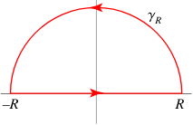
Contour integration: image

Slide 39
The second assignment
Contour integration – konturna integracija (not: konturno integriranje or konturno integraljenje)

Slide 40
Differential vector on a curve:
Translation: diferencijalni vector na krivOJ (not: na kriVI)

Slide 41
The second assignment: Tensor calculus
Tensor calculus – tenzorski racun

Slide 42
Flux
We have to differentiate between ‘two physical’\ contexts
Particle flux
Magnetic flux

Slide 43
Physical context: Magnetic flux and particle flux:
flux, magnetic The magnetic flux crossing a small area dA equals BndA, where Bn is the
field component perpendicular to dA. The flux crossing a finite area is accordingly the integral
B · dA over the area, and flux density is
magnetic flux per unit area. The magnetic flux
through a surface is sometimes referred to informally
as “the number of magnetic field lines
crossing it”.
Particle flux Total flux is the number of particles
per unit area crossing a given surface each
second. Differential flux is the flow of particles
per steradian crossing a given surface from
a particular direction

Slide 44
The second assignment: flux – translation
In Serbian we translate this word both as a flux, and as a fluksus

Slide 45
The second assignment

Slide 46
The first assignment: cuboid
We translate this word as ‘kuboid’ – if it is a noun, or ‘kuboidan’ if it is an adjective
Both words are derived from the Serbian word: kubus, which is an alternative word for: kocka
P. S. Take care about the pronunciation of the word: cuboid.

Slide 47
Definition of ‘cuboid’’
Closed box composed of three pairs of rectangular faces placed opposite each other and joined at right angles to each other, also known as a rectangular parallelepiped. The cuboid is also a right prism, a special case of the parallelepiped, and corresponds to what in everyday parlance is known as a (rectangular) "box."

Slide 48
Type of a cuboids:
Parallelepiped – we translate this as: paralelOpiped or ParalelEpiped (both are correct)
Prism, prismoid
We translate the word: prismoid as either ‘prizmoid’ or ‘prizmatoid’. (both arem correct)

Slide 49
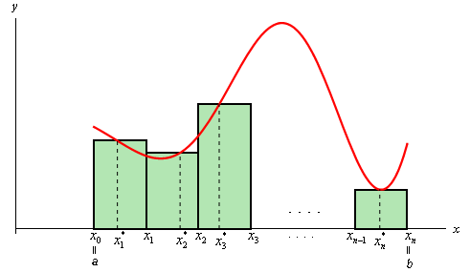
The first assignment: Double integral

Slide 50
The first assignment: Double integration
Ordinary integration, like ∫baf(x)dx , gives you the area under the curve y=f(x) , above the x-axis, and between the lines x=a and x=b . That's when f is a positive function. When f also takes negative values, then you get a signed area.
Double integration, like ∫ba∫dcf(x,y)dydx gives you the volume under the surface z=f(x,y) , above the xy-plane, and above the region described by the limits of integration. For the limits mentioned, that region is the rectangle consisting of points (x,y) for which a≤x≤b and c≤y≤d .

Slide 51
Double integration (II)
Single integration adds up rectangles to make an area. Double integration adds up slices to make a volume

Slide 52
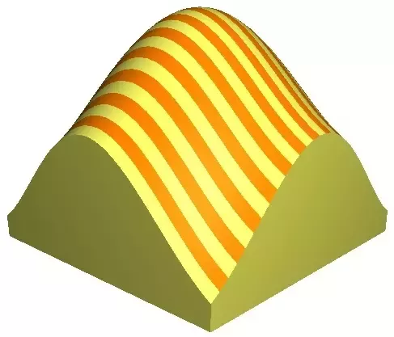
Geometrical interpretation of a double integral

Slide 53
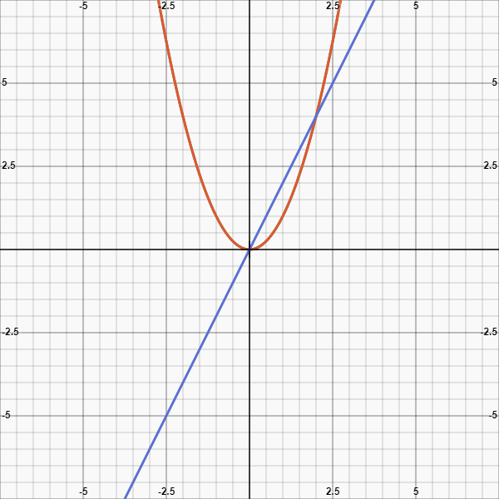

Slide 54
The fifth assignment:
You have already been expected to introduce all elements into your essay
Here is a short reminder as to what elements are to be introduced
We take as a point of departure that you have already worked out your outline
In case you have not already done it, especially, if I offered serious objections for your first midterm, please rework it and send it anew. DO IT FIRST!

Slide 55
The key elements to be done
Introduction 0.5
Taxes structure 0.5
Clarity 1
Linkage 1
Accuracy of style 1

Slide 56
The order of writing:
The first two elements (TAXES structure, and the introduction) represents units of composition
The second three elements represent the units of style
Please make sure that your TAXES structure and INTRODUCTION is firstly completed
At the second midterm, I will ask that you label each sentence by T) A) X) E0
Then work out the elements of style

Slide 57
The number of points (the fourth assignment – grading)
As previously (in the first midterm), the assignment bears 4 points in total
The additional elements of composition – TAXES structure + INTRODUCTION (bear one point respectively). 1 point in total
Elements of style bear 1 pt respectively (1 + 1+ 1= 3)
Clarity - 1 pt
Accuracy – 1 pt
Linkage – 1pt

Slide 58
Suggestion about the preparation of your essay
It generally does not matter which of the criterion you will fulfill the first, and which the next one
It is up to your choice. If I were you, I would first complete the Clarity part and leave the Linkage-transition part to be the last one (the principal reason being that students are often found struggling with the clarity part). Yet it is up to you.
What really matters is that each requirement is done in full. Thus, do not skip over to the accuracy part or the transition part, if you are not completely certain that you have already not done the clarity part and vice versa

Slide 59
Why is this order important to follow and stick to?
An explanation: it is very difficult to establish the accuracy of style without first maintaining the TAXES structure

Slide 60
The essay introduction – material
Kathleen Muller’s book: The thesis statement
Pages 101 – 103
Please give a particular consideration to the parts:
A) Things to avoid in an introduction (102)
B) Strategies of introduction (103)

Slide 61
TAXES STRUCTURE – MATERIAL
Material – Kathleen Muller’s book pages 104 -107 (Take an especial care of the page 106, where you will find a clear example for each the sentence – type)
I have posted Kathleen Muller’s book both within the folder titled LITERATURE and the folder: MIDTERM2 the FIFTH ASSIGNMENT

Slide 62
Elements of clarity
Start most sentences with the subject (avoid using a passive)
Avoid using dependent clauses (wh-clauses which, who, where and when clauses)
Avoid using complex sentences (if necessary, break up a complex sentence into two or even three simpler)
Keep subjects and verbs close together
Keep single verbs with multiple subjects, use single subjects with multiple verbs
Choose positive rather than a negative construction
Avoid using contractions (not: don’t, but do not, not won’t, but will not)
End sentences with a Bang not a whimper
Avoid using superfluous expression

Slide 63
Elements of clarity (material)
Material: Take a look at the folder The Fourth fifth assignment and find therein a file: rules of thumb. You will find a file tiles Rules of thumbs and plenty of useful examples

Slide 64
Elements of accuracy (1 pt)
Make your subjects definitely clear actors
Make your verbs definitely clear actions
Eliminate weak verbs as much as possible and use only the strong ones
Material: Take a look at the folder The Fourth fifth assignment and find therein a file: rules of thumb. You will find a file tiles Rules of thumbs and plenty of useful examples

Slide 65
Elements of cohesion (1 pt)
Use linkage
Use elegant variation
Use cross- reference
Use linking adverbials

Slide 66
Elements of cohesion: material
Please consider the file found in the folder The midterm 2: the fourth assignment
The file is titled as: Linkage, transition, cohesion, cross-reference

