Slide 1
Game Marketing
Becoming Visible and Staying Visible

Slide 2
Marketing 101
What to Say (and What Not to Say)

Slide 3
Game Marketing 101
Competition between game projects once released, and their need for effective marketing, is at an all-time high. When marketing a project, developers need to determine the following:
What to say
Where to say it
How to approach press and potential market partners

Slide 4
What are you trying to achieve?
All marketing requires marketers to work out exactly what they’re trying to accomplish and how they’d like to be recognized.
Are you trying to establish yourself as a leader?
As something novel and unique?
Are you trying to promote a newsletter, demo, or game release?
Will you be recognized as approachable or as something more exclusive?
Establishing the general message, the public identity of the team, and the purpose of the messaging is essential for working out a cohesive media strategy.

Slide 5
Positivity
Announcements from development teams should always try and be positive and/or objective. Wherever possible, they should include reasons for the audience to return to the platform where they received the message.
“Every Thursday we’ll be releasing a new clip of footage, so make sure to subscribe to our YouTube channel so you don’t miss out!”
“As development ramps up, we’ll be releasing more screenshots of unseen areas. You won’t want to miss this, so make sure to follow!”

Slide 6
Calls to Action
Statements and announcements should be pushing the audience to be doing something—for example:
Subscribing to a social media channel
Purchasing a game
Trying out a new update
Signing up for a newsletter
Coming to your team booth at an expo
A call to action helps move the audience from observing to participating.

Slide 7
What are you trying to achieve?
Identifying your target demographic, which platforms they use to receive updates, and how they’re likely to engage your marketing and product are important in establishing your message.
Your message needs to be clear, targeted, and appropriate for the format and audience. Are you appealing to more than just Western markets? Many people localize their products, but should you be localizing your social media too?
Gamer demographics at a glance:
The average gamer is 35 years old.
Gamers are 58% male, 42% female.
Men purchase nearly twice as many titles as women; however, women are a third more likely to make in-app purchases.
Two-thirds of parents play games with their children weekly.
The top five countries by game revenue are China, the United States, Japan, South Korea, and Germany.

Slide 8
Marketing 101
Where Do I Say It?

Slide 9
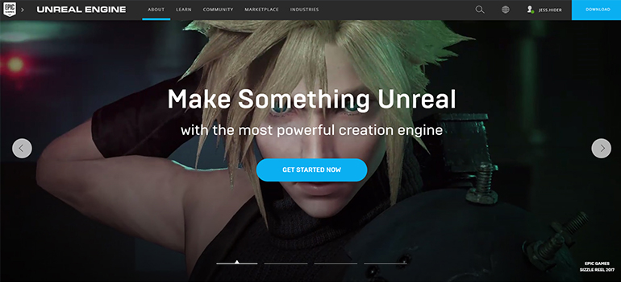
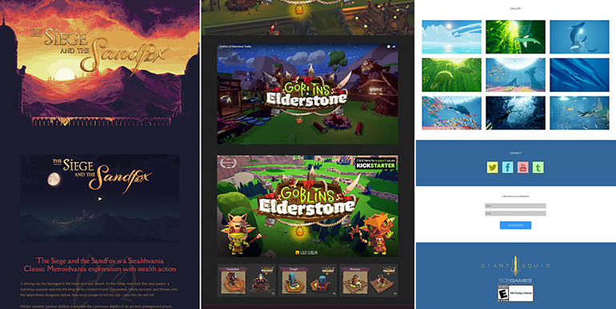
Websites
Websites are a central hub for your online presence. All other channels that you use should link back to them, so websites need to be well maintained and presented. It’s important to keep a clean design with easily accessible links to your press kit, trailers, and all social media channels.
The Siege and the Sandfox, Goblins of Elderstone, and Abzu

Slide 10
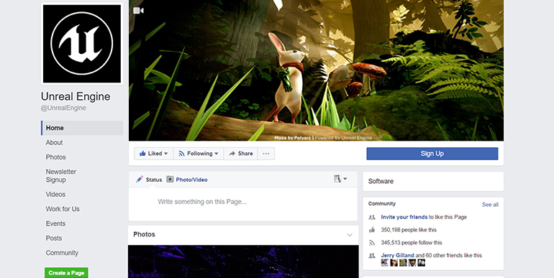
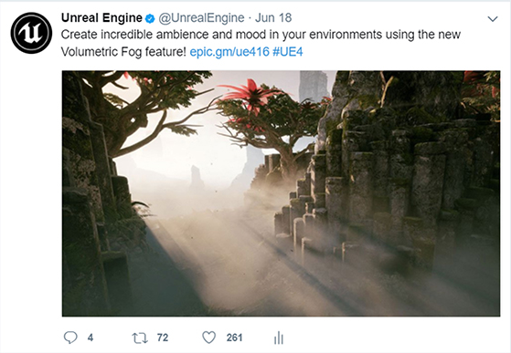
Facebook
Facebook has the largest user base of any social media platform. Facebook posts reach a wide audience; however, be wary of sending multiple posts per day, since the Facebook algorithm begins to hide repeat posts by pages. One of Facebook’s main strengths is that it allows for more detailed posts. The posts can contain more text than Twitter or Instagram posts, and Facebook gives previews to where your posts are linking to, which can be useful.
You can now use a video clip as your page banner, instead of just a static image.
Facebook lets you create custom tabs (pages), so make use of them to create dedicated links for signing up to receive newsletters or for finding you on Kickstarter.

Slide 11
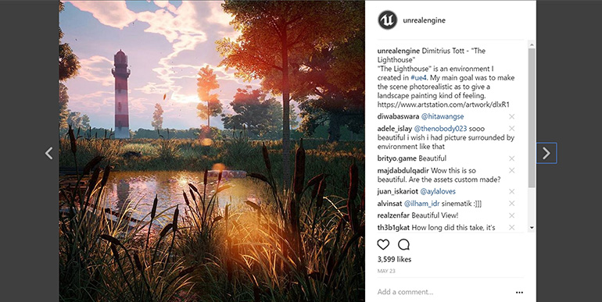
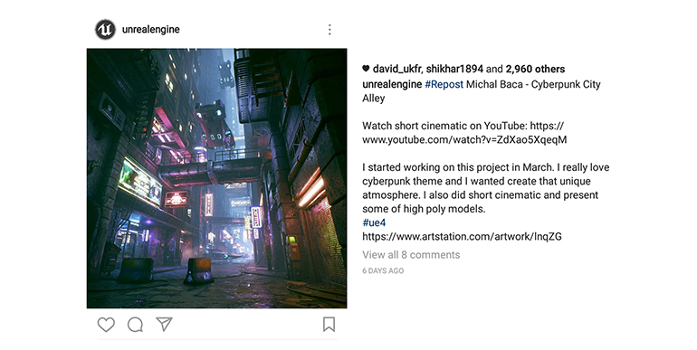
Instagram
Instagram has a higher engagement rate than either Facebook or Twitter. Reposting is less common, but likes and comments are greater, making it a good place to gather feedback and engage customers in a dialogue.
When posting on Instagram, be aware that there’s no easy way of clicking on links in a post and that long pieces of text are truncated, so the image typically has to be the focus of the post.
Remember that Instagram is about the visuals, so focus on high-fidelity images and remember that text-heavy images are less likely to be shared.
When uploading a video, make sure the first frames look as good as a picture—there’s a half-second delay before a video starts, so if someone’s scrolling down their feed and you can’t get them to pause, they will never see the video.

Slide 12
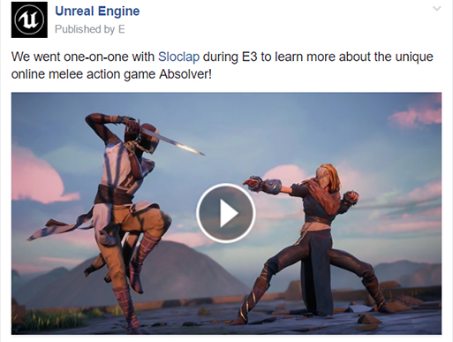
Twitter
Twitter is about short, sharp posts, and because it’s built around sharing content with others via retweets, it has a very wide reach. Due to the short character counts, Twitter has a dialogue that can be hard to maintain.
When posting on Twitter:
Don’t start tweets with @PersonsName, as the tweet will only appear on that person’s timeline and not be visible to the rest of your followers.
If you use an image, you can tag up to 10 people in the image, saving on character count.
When showing off video, always directly upload it to Twitter rather than linking out to YouTube, since direct uploads play automatically when scrolled past.

Slide 13
YouTube
Once you pick a “slug,” you can never change it, which is something to keep in mind if you plan on releasing multiple games. If you’re creating custom thumbnails, watch out for YouTube’s “watched bar” and “timecode” stamp, which cover valuable space in your design.
Use your channel home page to create sections, which among other things can contain playlists of playlists.
Video Services
Video services offer a unique avenue for advertising and publicizing content. YouTube and Twitch both allow for live streaming, which is saved for later viewing. Remember that there are several factors that affect the SEO of your videos, with watch time being more valuable than likes or follows. Keep your content appropriate for those under 18 and avoid swearing or working on anything explicit.
Twitch
Build informative UI to let your viewers know what’s coming up.
Make yourself accessible: link out to your Twitter account, website, blog, and similar platforms so people can find you.
Artists do the best for viewers, followed by programmers.

Slide 14
Developing
Content
Because social media content can potentially go viral, it’s important to develop content that focuses on quality over quantity. This emphasis ensures that the content developed will be displaying the project in the best possible light.
Following are some useful tips for creating content:
Only display content that is relevant to what you intend to display. For instance, if a screenshot doesn’t need the editor to be visible, you don’t need to show it.
When showing videos of an environment, Sequencer can be used to produce smoother and more professional videos than a typical playthrough with a mouse and keyboard.
Ensure that content has been developed to the correct aspect ratio and resolutions for the platform it will be posted to.
When recording video content, be sure to use proper video-recording software and not an external mobile device.
Schedule your content for time zones that match your audience.

Slide 15
Marketing 101
Who Can Help and How Do I Approach Them?

Slide 16
Contacting the press
The first step to take before contacting the press and promoting your game is to identify which press to contact.
While the obvious first choice may be to single out the most highly visited sites, such as Kotaku, IGN, and Polygon, strong competition in the game industry limits an indie’s chances of getting picked up by one of these sites.
But not all is lost.

Slide 17
Contacting the right press
Although the odds that the larger sites are out of reach may be daunting, there are other options:
Seek out smaller sites, bloggers, and vloggers that may respond best to free keys for reviewing/previewing.
Identify which of the larger sites have sections devoted to games that fit your profile.
Locate specialist sites that fit your project.
Research who you’re pitching to, and try to understand what kind of content they’re after and what angle they’ve taken on similar projects.
Consider personally emailing as many of these sites as possible to avoid your email coming across as spam with generic messages.
When you reach out, make sure that your email has an actionable response.

Slide 18
Spreading information about your project goes much more smoothly with a press pack that can be easily linked to in your emails and website.
Content typically covered includes the following:
Game name
Studio name
Studio region
Publisher name, if applicable
Website + social links
Contact details
Trailer (a link to both a YouTube version and a downloadable version)
Key art
Screenshots (high resolution and no logo, making it easier for cropping and formatting for articles)
Logo
Description of the game/press release
Because your project may be described in a range of contexts, it’s important to provide alternative versions of your project description. Say what it is in
Less than 116 characters (this allows a link in a tweet)
Two sentences
A paragraph
A page
Press Packs

Slide 19
Online Etiquette
When contacting the media, try to keep a few things in mind with regard to etiquette:
Use correct English and grammar.
Don’t make anyone feel like you’re wasting their time, and make sure you have actionable responses for them.
Remember that journalists hop between exhibitions and conferences quite frequently. If you don’t receive a response straightaway, feel free to write a follow-up after a week or more, but don’t pursue the matter any further. Sometimes it can take a month to get a response, and sometimes there’s no response at all. Continuous follow-ups will burn goodwill.

Slide 20
Other Marketeers
In addition to reaching out to games news websites, it’s possible to reach out to potential affiliates. Have some new art that used Substance or Quixel? Why not tag them in your tweets! Been working away in Maya, 3ds Max, or Marmoset? Consider tagging them!
Larger companies in the industry often repost content online and are keen to share the work of their customers. This shared content can reach a very wide audience and help.

Slide 21
Conclusion
Questions?

