Slide 1
Shipping and Releasing
An Overview of the Process

Slide 2
Distribution and Deployment
What Is It?

Slide 3
Compile
Cook
Release
Package
Distribution and deployment process
When a project is ready for distribution, it must go through several steps before it can be given to testers, customers, or potential publishers. Following are some of the steps that will be taken during the packaging process:
When a project has a custom source code, this code will first be compiled.
All required content will be converted, or “cooked,” into a format that can be used by the target platform.
Compiled code and cooked content will be bundled into a distributable set of files, such as an installer for Windows.

Slide 4
What’s in the build shouldn’t necessarily be in the game.
As a game is developed, it accrues a large amount of ancillary data that will never need to be in the shipped product, and its files are often stored in a format more conducive to development.
Cooking is the act of processing the build before distribution.
The cooking process generally includes the following operations:
Unreferenced content is removed from the game.
Textures are analyzed, according to their groups, and mipmaps above a defined maximum size are removed.
Content is converted into platform-specific formats.
Where possible, content is compressed into formats that are memory efficient and/or more performant.
Content related to the editor is identified and removed.
Files are consolidated into a single .pak file (this operation is optional).
This .pak file may or may not be encrypted.
This process results in a distribution build that is more performant, is smaller in file size, and uses less memory at runtime.

Slide 5
Unreal Tournament 4
Due to the format conversion of assets and the stripping out of unnecessary assets, the final size of a packaged build can be substantially reduced. For example, the size of an Unreal Tournament 4 build drops from 42GB down to 8GB after being packaged.

Slide 6
Distribution and Deployment
Packaging Your Project

Slide 7
Debug
Packaging Configurations
DebugGame
Games can be packaged with different “configurations” per platform:
Debug
DebugGame
Development
Shipping
Test
Each configuration performs different optimizations. When releasing a game to the public, the Shipping configuration is generally used.
Development
Shipping
Test

Slide 8
Debug
Packaging Configurations:
Debug
DebugGame
The Debug configuration contains symbols for debugging. This configuration builds both the engine and game code in debug configuration. If you compile your project using the Debug configuration and want to open the project with the Unreal Editor, you must use the “-debug” flag to see the code changes reflected in your project.
Development
Shipping
Test

Slide 9
Debug
Packaging Configurations:
Debug Game
DebugGame
The DebugGame configuration builds the engine as optimized but leaves the game code in a debug state. This configuration is ideal for debugging only game modules.
Development
Shipping
Test

Slide 10
Debug
Packaging Configurations:
Development
DebugGame
The Development configuration is equivalent to Release. Unreal Editor uses the Development configuration by default. Compiling your project using the Development configuration enables you to see code changes made to your project reflected in the editor.
Development
Shipping
Test

Slide 11
Debug
Packaging Configurations:
Shipping
DebugGame
The Shipping configuration is used for optimal performance and shipping your game. This configuration strips out console commands, stats, and profiling tools.
Development
Shipping
Test

Slide 12
Debug
Packaging Configurations:
Test
DebugGame
The Test configuration is the same as the Shipping configuration but with some console commands, stats, and profiling tools enabled.
Development
Shipping
Test

Slide 13
Distribution and Deployment
Platform Options

Slide 14
Platforms:
PC (Non-Steam)
Packaging and deploying a project for PC is the most straightforward form of deployment. It simply produces a folder with your final game in it. You can zip this folder to share with friends or upload it to a website like itch.io for people to download.

Slide 15
Platforms: Steam
If you wish to publish your game to Steam, you must first be a Steam Partner. To become a Steam Partner, teams can sign up through Steam Direct. Steam Direct requires a fee and has content guidelines for what you can and can’t publish to its platform.
To prepare your game for deployment to Steam, you simply need to package it like you would for a non-Steam release. After that, Steam’s content packaging requires you to write specific scripts to determine what content from your game needs to be uploaded into a “depot.” Every time you make a new release, you must run this script to upload your content to Steam. These tools come as part of the Steamworks SDK, which you can download once you become a Steam Partner.

Slide 16
Platforms: Android
Packaging for Android is slightly more involved than for PC, as different devices require some assets to be in a specific format. This requirement is due to the differences in the graphics chips and how they render various textures.
To package and deploy for Android, you must ensure that Codeworks for Android is installed. Codeworks is bundled as part of Unreal Engine 4.
Android packaging produces several different kinds of output files, including the following:
An APK file containing your binary code (that is, the engine itself, any C++ code you have written, and additional supporting libraries for the platform)
An OBB file containing all the actual art assets for your game
Google Play has file size limits on APK files, which is why OBB files of content are provided separately. Publishing to Google Play requires you to sign up for a Google Play account for a one-off fee.

Slide 17
Platforms: ios
Packaging a project for iOS is even more involved. Once you are signed up as an Apple Developer (requires an annual fee), you must go through the process of generating certificates and provisioning profiles before your game can be deployed to a device.
In order to package your game for iOS, you must have iTunes installed. Also, if you have written any C++ code, you require a Mac to compile any code you have written for final use.
iOS packaging produces a single IPA file containing all of the binary code and art assets that your game needs for distribution.

Slide 18
Platforms: Console
Consoles, such as the Switch, PS4, and Xbox One, each have their own specific rules and guides for how to package your game. Unlike other platforms, you must be an approved development partner with the company to obtain any specific hardware, agreements, and software that may be required for development. However, generally speaking, each console has similar processes for releasing a product, which involves submission and reviews.
Consoles also have a technical requirements checklist (TRC), which is a list of functionalities that your game must include in order for it to pass review. The contents of these documents are confidential, but they generally include technical, usability, and error-handling requirements.

Slide 19
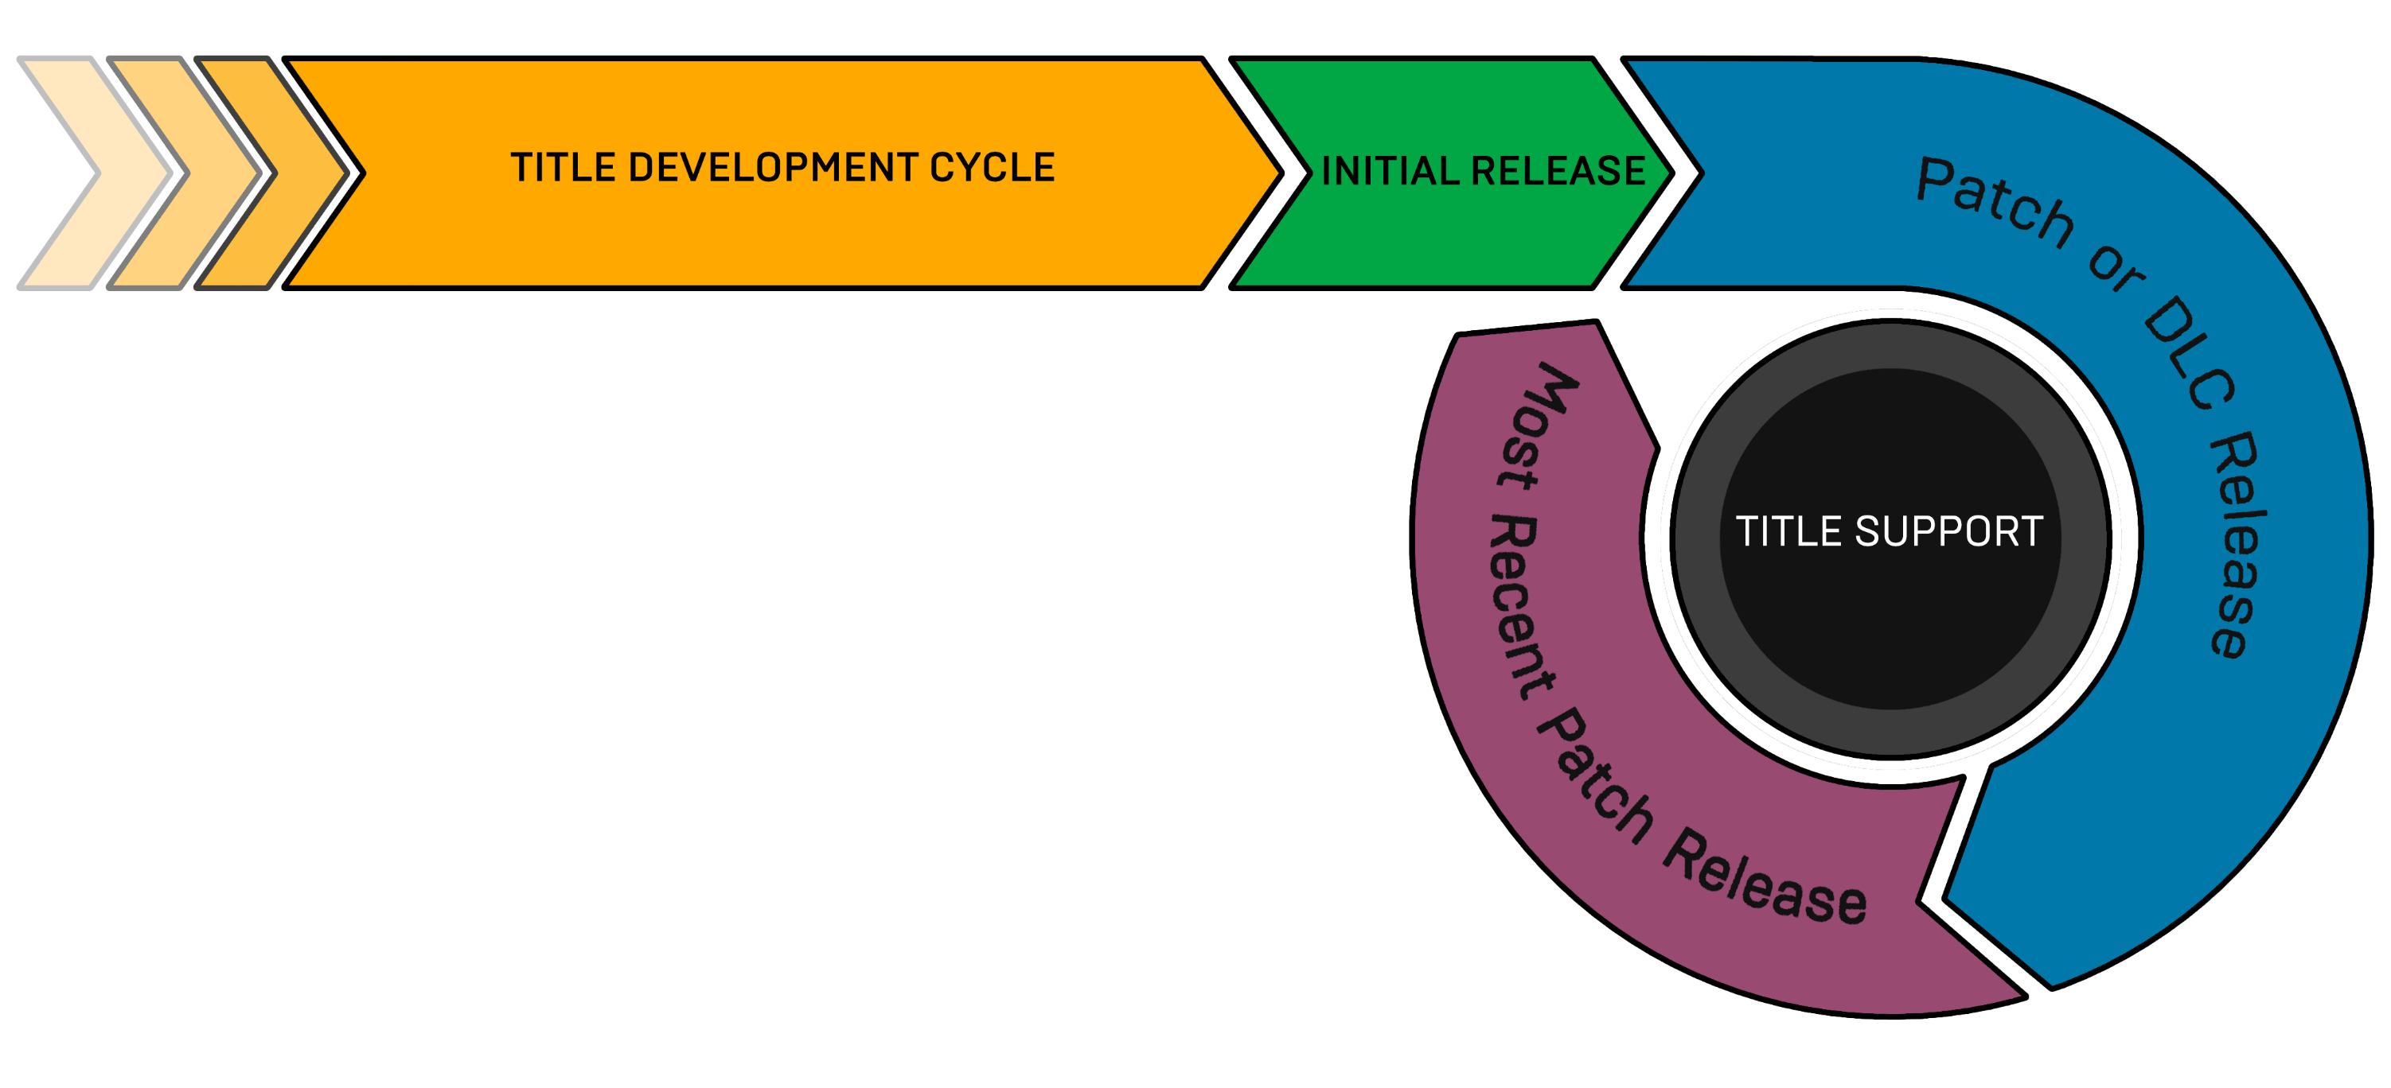
PAtching
You will probably need to update your game after you have released and deployed it in order to fix bugs or add new features and content.
To update your project after release, you can use the patching process. During patching, the engine compares all the content post-cook to the originally released cooked content to determine what needs to be included in a patch.
The method you use to get the patch’s .pak file to the users will depend on your distribution platforms, but this procedure will allow you to create a much smaller .pak file that just contains the updated content.

Slide 20
Conclusion
Questions?

