Slide 1
Developing as a team
Team Roles, Project Management,
and Mitigating Burnout

Slide 2
Project Management
Delegating Tasks and Project Roles

Slide 3
Project Management Overview
The core purpose of project management is to manage the planning and execution of a project by a team of people. While different projects will have different goals and challenges, a common challenge of all projects is facilitating effective communication between members of the team to ensure everyone is working toward the same goal.

Slide 4
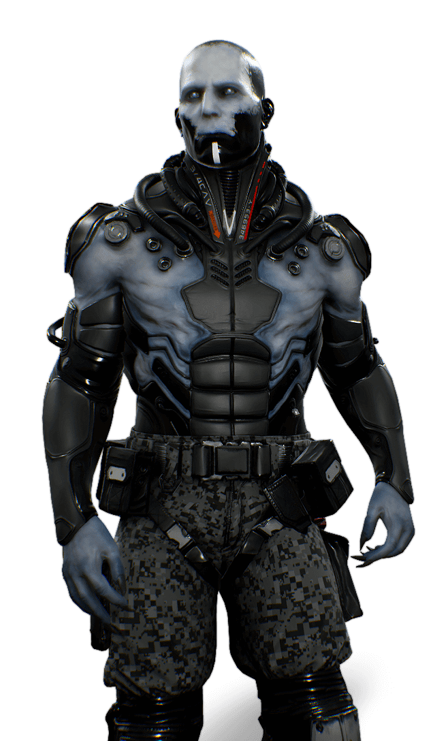
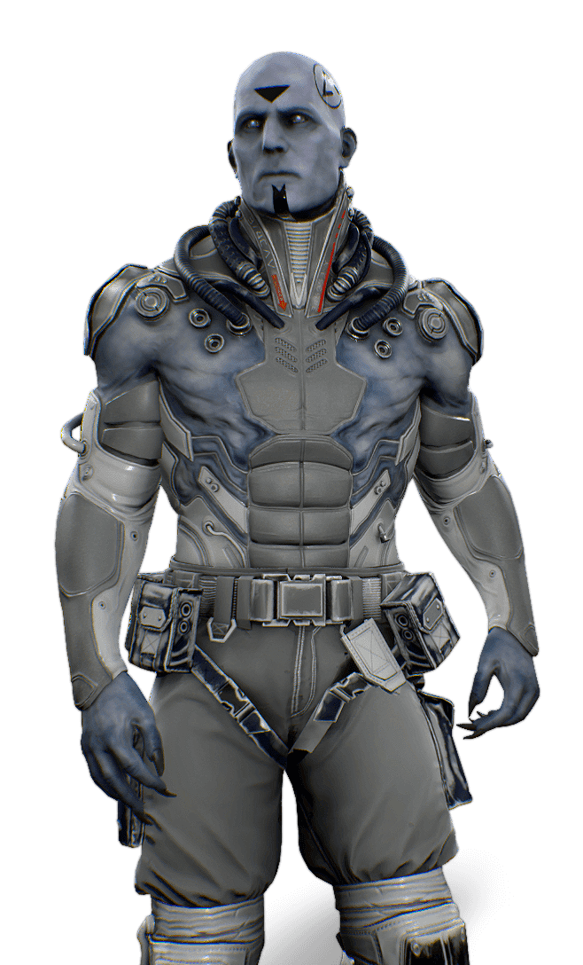
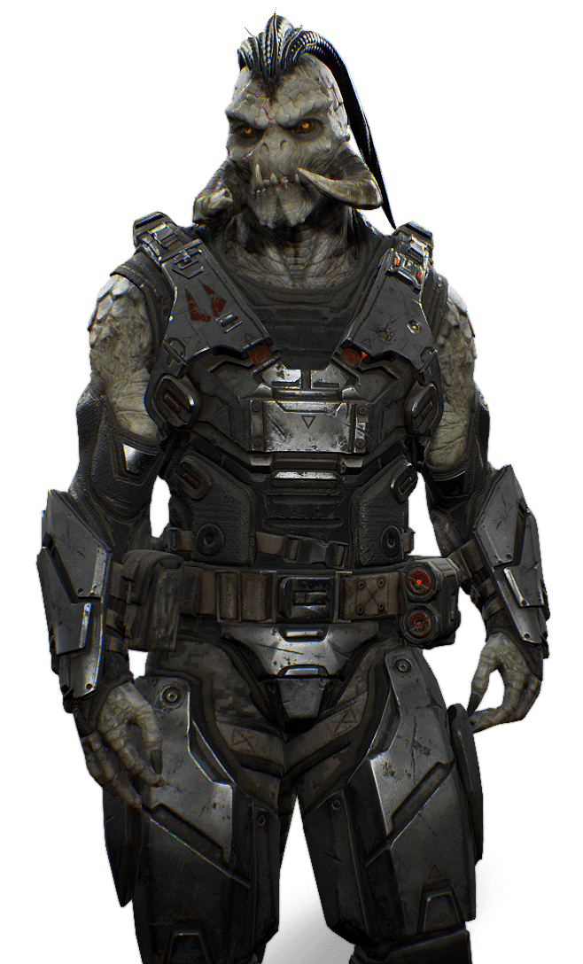
Common Roles
Modern game development involves a large array of specialized roles over a number of disciplines. The larger a development team, the more specialized the roles tend to become, whereas smaller teams tend to encourage individuals to take on responsibilities and tasks across multiple disciplines.

Slide 5
Game designers are often responsible for planning and iterating mechanics.
Artists are responsible for the bulk of the visual content in a project.
Game Designer
Artist
A game designer conceives and designs the rules and structure of a game, including game mechanics, controls, narrative, and story and user interface. Their role often involves overseeing the implementation of their designs by team members in other disciplines.
An artist creates visual art for the game. An artist can specialize in 2D art, including concept art, textures, user interface, and environment backgrounds, and in 3D art, including 3D models and animations.

Slide 6
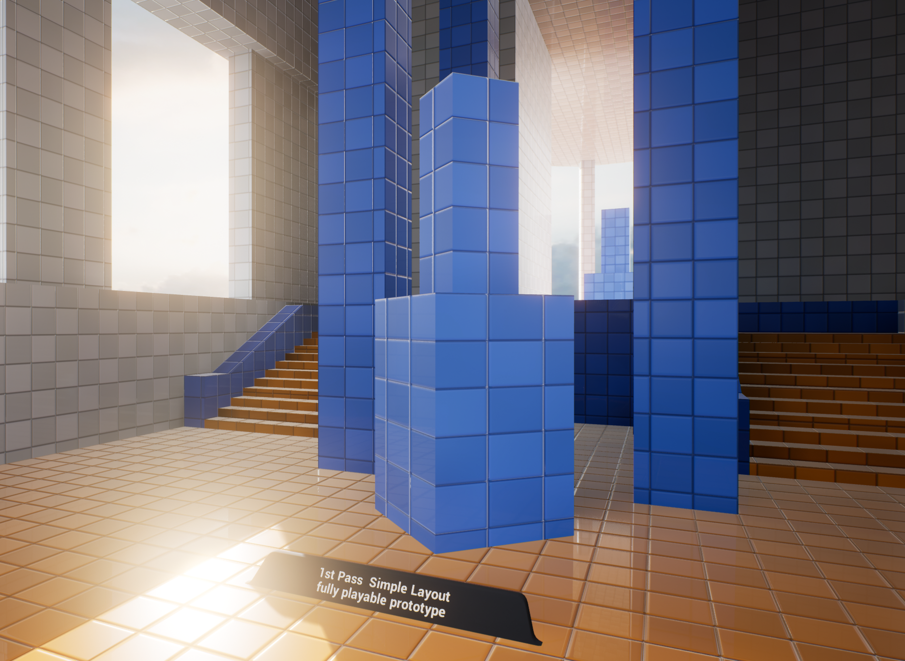
C++ code
White room of a map prior to meshing
Programmer
Level Designer
Programmers develop the software both for the game and to facilitate the development of the game by team members in other disciplines. Common components of a game that a programmer will develop include gameplay, AI, physics, graphics, UI, networking, and development tools.
A level designer constructs levels, puzzles, scenarios, and missions for games. Often level designing involves pulling together work from other disciplines to construct the experiences for players.

Slide 7
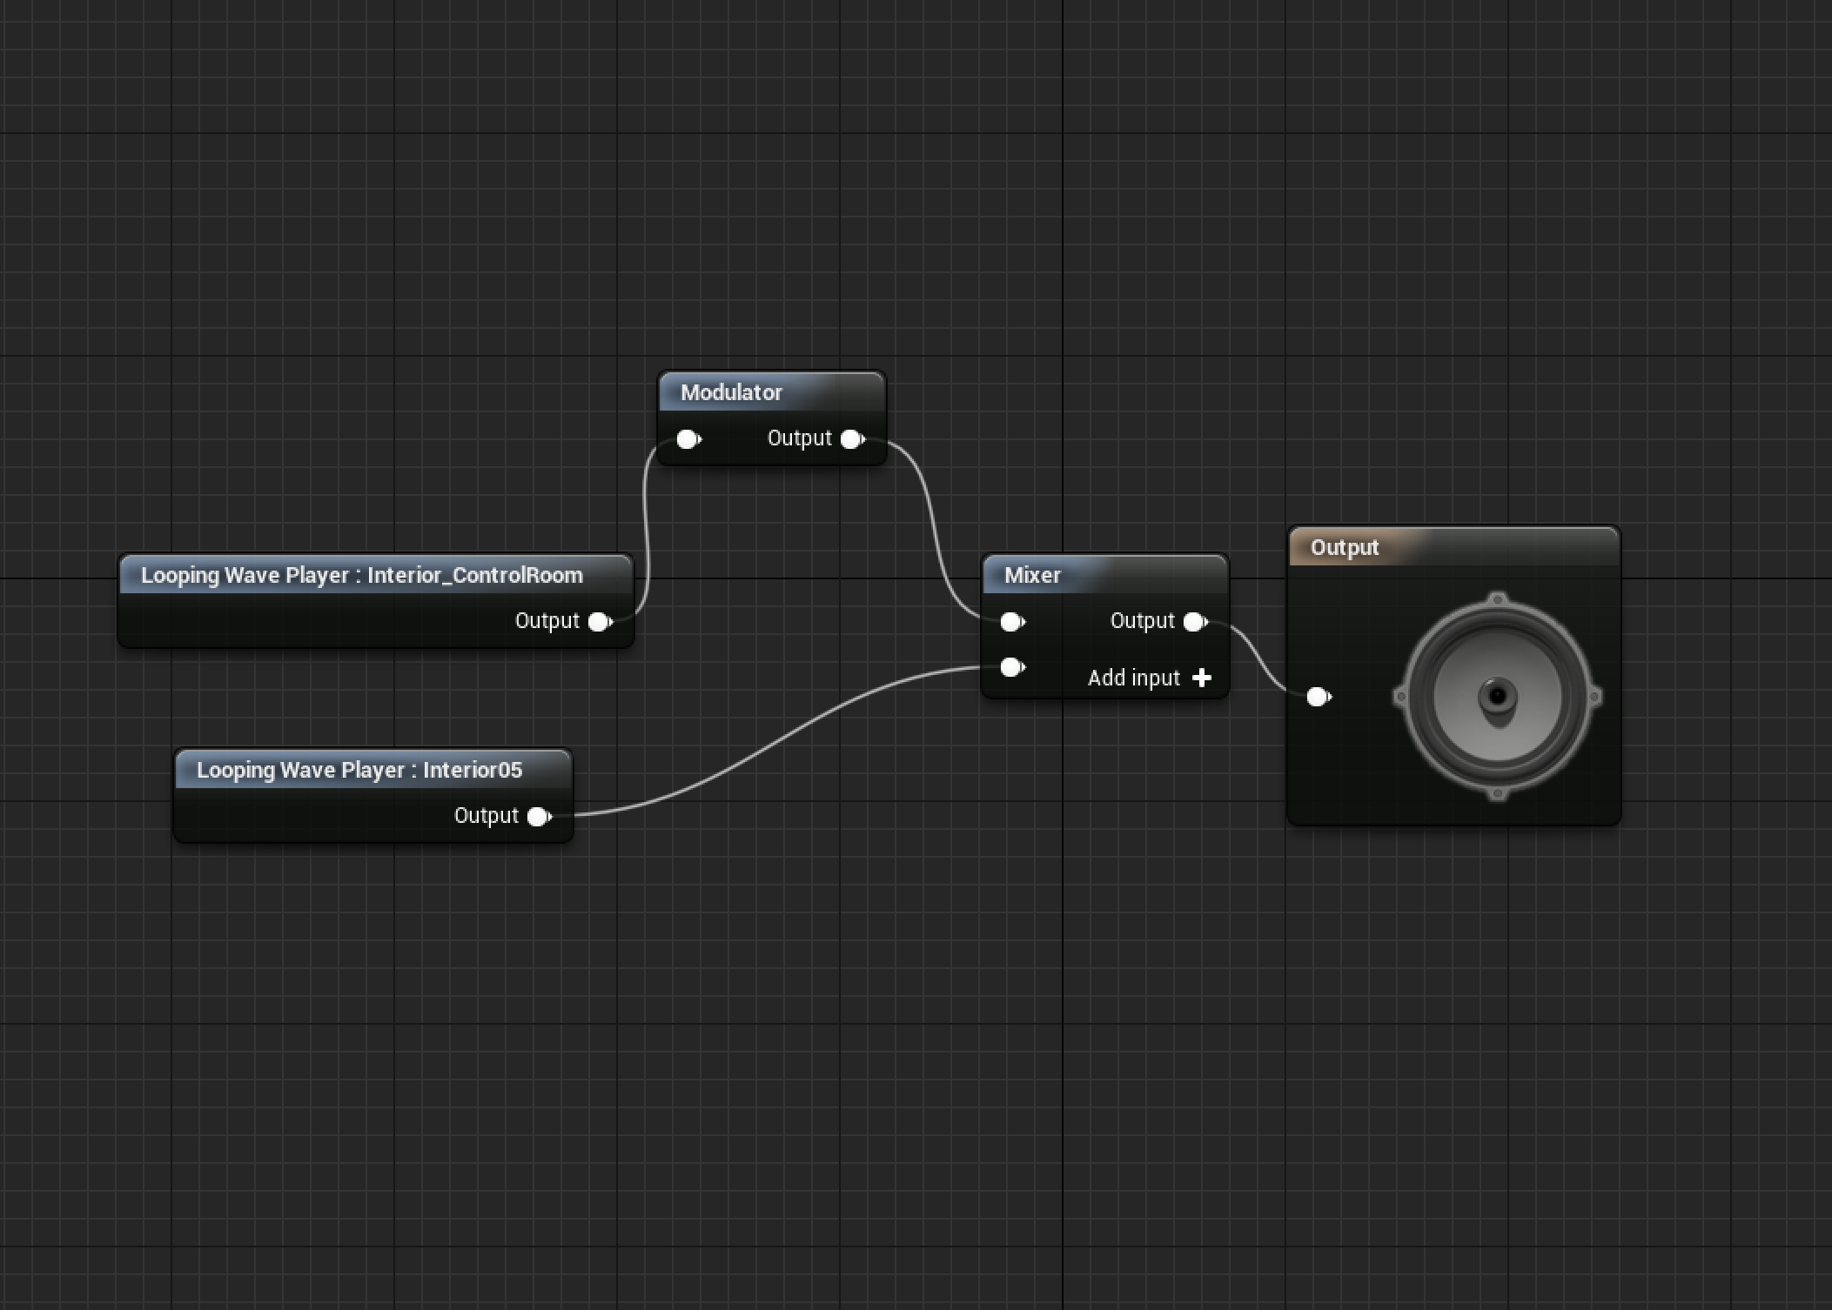
Tech artists handle explosions, pickups, and everything in between.
Audio engineers handle audio both inside and outside of Unreal.
Technical Artist
Audio Engineers
Technical artists are specialists with proficiency in various processes of 3D graphics rendering. They act as a bridge between programmers and artists to help facilitate the creation of art and its integration into the game as well as to ensure that programmers are aware of the technical requirements of the artists and the art they need to create.
Audio engineers record sound effects, music, and voice-overs and prepare them for use within a game.

Slide 8
Project Manager
A project manager oversees projects from a high level. They coordinate members of teams and subteams while ensuring that everyone is working toward a collective aim.
QA Tester
QA testers test all features of a game to find bugs and usability issues while helping to refine and balance various components and mechanics of a game.
Infrastructure
Infrastructure team members ensure that the underlying toolsets and infrastructure requirements of a team are in place and stable.
Marketing and Outreach
Marketing handles customer interactions and outreach through a range of platforms, including social media, email, and physical media.

Slide 9
Development MEthodologies
Deciding on a method of development early on is key to ensuring that all team members know what they are working on and how everything fits together. There are many formal development methodologies, most of which fall broadly under the categories of Waterfall and Agile.

Slide 10
Development MEthodologies
Waterfall
Agile
Waterfall methodologies approach the major development tasks (analysis, design, building, and testing) as distinct phases to be completed in a linear fashion. They require a large amount of initial planning; however, they adapt poorly to unforeseen issues or changes to requirements. They are best used in smaller, well-scoped projects, as they allow a greater overall picture of how the components of the project fit together, which simplifies planning and provides a clear indication of progress during development.
Agile methodologies break a project into small chunks, often blocked out by set time periods, and then work through the major development tasks (analysis, design, building, and testing) on each chunk before moving on to the next. This means that planning is done periodically and that changes in requirements and new discoveries made during development can be adjusted to. Agile methodologies are best used in larger, complex projects, where the full design isn’t initially known or is likely to change/evolve during development due to experimentation and testing, as the frequent planning allows developers to adjust to those changes in design while considering other factors such as deadlines.

Slide 11
Delegating Tasks within a Team
It is important that individuals know not only what they themselves are working on but also what other members of the team are working on, what work has already been done, and what work still needs doing. This knowledge is important for planning purposes, tracking progress, and ensuring that different team members’ work combines well, that work doesn’t get done twice, and that work doesn’t get forgotten.
There are different methods of keeping track of a project, from simply keeping a to-do list on a whiteboard (useful for small projects) to using issue tracking software (necessary for more complex projects and larger teams, especially if team members work remotely). Some formal development methodologies require specific practices of task delegation and record keeping.

Slide 12
The “Truck Factor”
If a team member were to leave tomorrow, how would your project development continue? How well would other members be able to adapt to filling the departing member’s role or to retraining a new team member to fill the role?
This issue is known as the truck factor. It can be mitigated in the following ways:
Maintaining documentation, especially on features that involve only a single team member
Redundancy of skill sets between team members to ensure that no employee is singularly trained in a role

Slide 13
Source Control
Maintaining Your Project over Time

Slide 14
What are the Options?
Solution A
Solution B
Solution C
When developing games, it’s important to carefully control how files are stored, structured, and transferred among team members. To this end, it’s important to use a method of source control that ensures all team members have a unified build of the project.
Source control comes in many different forms; however, the three most commonly used are
Perforce
Git
Subversion

Slide 15
Central Repository
Client A
Client B
Client C
Working Copy
Working Copy
Working Copy
Basic Source Control
At its simplest, source control systems maintain a central repository of the project’s files, where users can check out a copy of those files to their development machine. Once the files are checked out, users can commit any changes they make to the files back to the central repository as well as update their local copy with any of the changes that other team members have committed. This is called centralized source control, and Perforce and Subversion employ this method.

Slide 16
ADvanced Source Control
Client B
Client C
Client A
Repository
Repository
Repository
A more advanced method of source control is called distributed source control. This method removes the reliance on an authoritative central repository and allows for many repositories, including a full repository for each team member.
Team members can work on their own repository and then push and pull changes from any of the other repositories. This approach allows developers to maintain the benefits of source control without always needing to consider the effects their work in progress might have on other team members.
This benefit comes at the cost of some added complexity and a larger learning curve for new users. Git is a popular solution that uses distributed source control.

Slide 17
Advantages of source Control
Revision history
Branching
Tagging
Reversion
Distributed backups
In addition to enabling collaboration, source control maintains a record of the changes made to a project over time, making it a useful tool for solo developers as well as for teams. This is a very powerful feature during development, as it is often desirable to go back through previous versions of a project to identify when a bug was introduced, which can narrow down how that bug was created.
Maintaining a copy of the changes over time allows a developer to easily revert back to an earlier version of the project and to reverse any changes they have made that were a mistake, in particular if the mistake would be difficult to manually reverse, such as by deleting a portion of work.

Slide 18
Burnout and Crunch
Managing Health Risks during
Project Development

Slide 19
Burnout & Crunch
Game development attracts many developers from different disciplines who are deeply passionate about games and their work.
When combined with hard deadlines and evolving and unpredictable technology, there is a tendency for developers to work longer days than is typical of many professions as well as to invest highly in the success and failures of their work. At times this tendency can be extreme, impacting both the physical and mental health of developers.
This kind of response is colloquially referred to as burnout. Burnout is something you as a developer need to try and be aware of not only in yourself but in your fellow team members as well.

Slide 20
Physical or emotional exhaustion. This can make you feel tired, weak, drained, or detached.
Insomnia
Difficulty concentrating, and forgetfulness
Getting sick more than usual (for example, with a cold or the flu)
Unexplained physical symptoms such as headaches, dizziness, or stomachaches. Make sure to get these checked out by a doctor.
Loss of appetite and/or weight loss
Anxiety. This not only means feeling nervous, but also can present with a sense of dread, tension, irritability, and racing thoughts that interfere with concentration.
Depression. This not only means feeling sad, but also can mean feeling guilty, worthless, hopeless, and/or suicidal.
Loss of enjoyment. This doesn’t have to apply just to work but eventually may spread to areas of social and family life. Please note that loss of enjoyment is also a symptom of depression.
Pessimism. If you feel detached and ineffective, you may feel disillusioned with your career.
Isolation. Social interaction is important for mental health and well-being. When employees are experiencing depersonalization, they may not feel like talking to their colleagues, clients, or customers.
Apathy. “What’s the point in trying?” This attitude further decreases one’s sense of self-worth and purpose.
Lack of productivity and poor performance
—Adapted from Jennifer Hazel, “Crunch and Burnout,” July 28, 2016,
CheckPoint, https://checkpoint.org.au/burnout/
Common Symptoms of Burnout

Slide 21
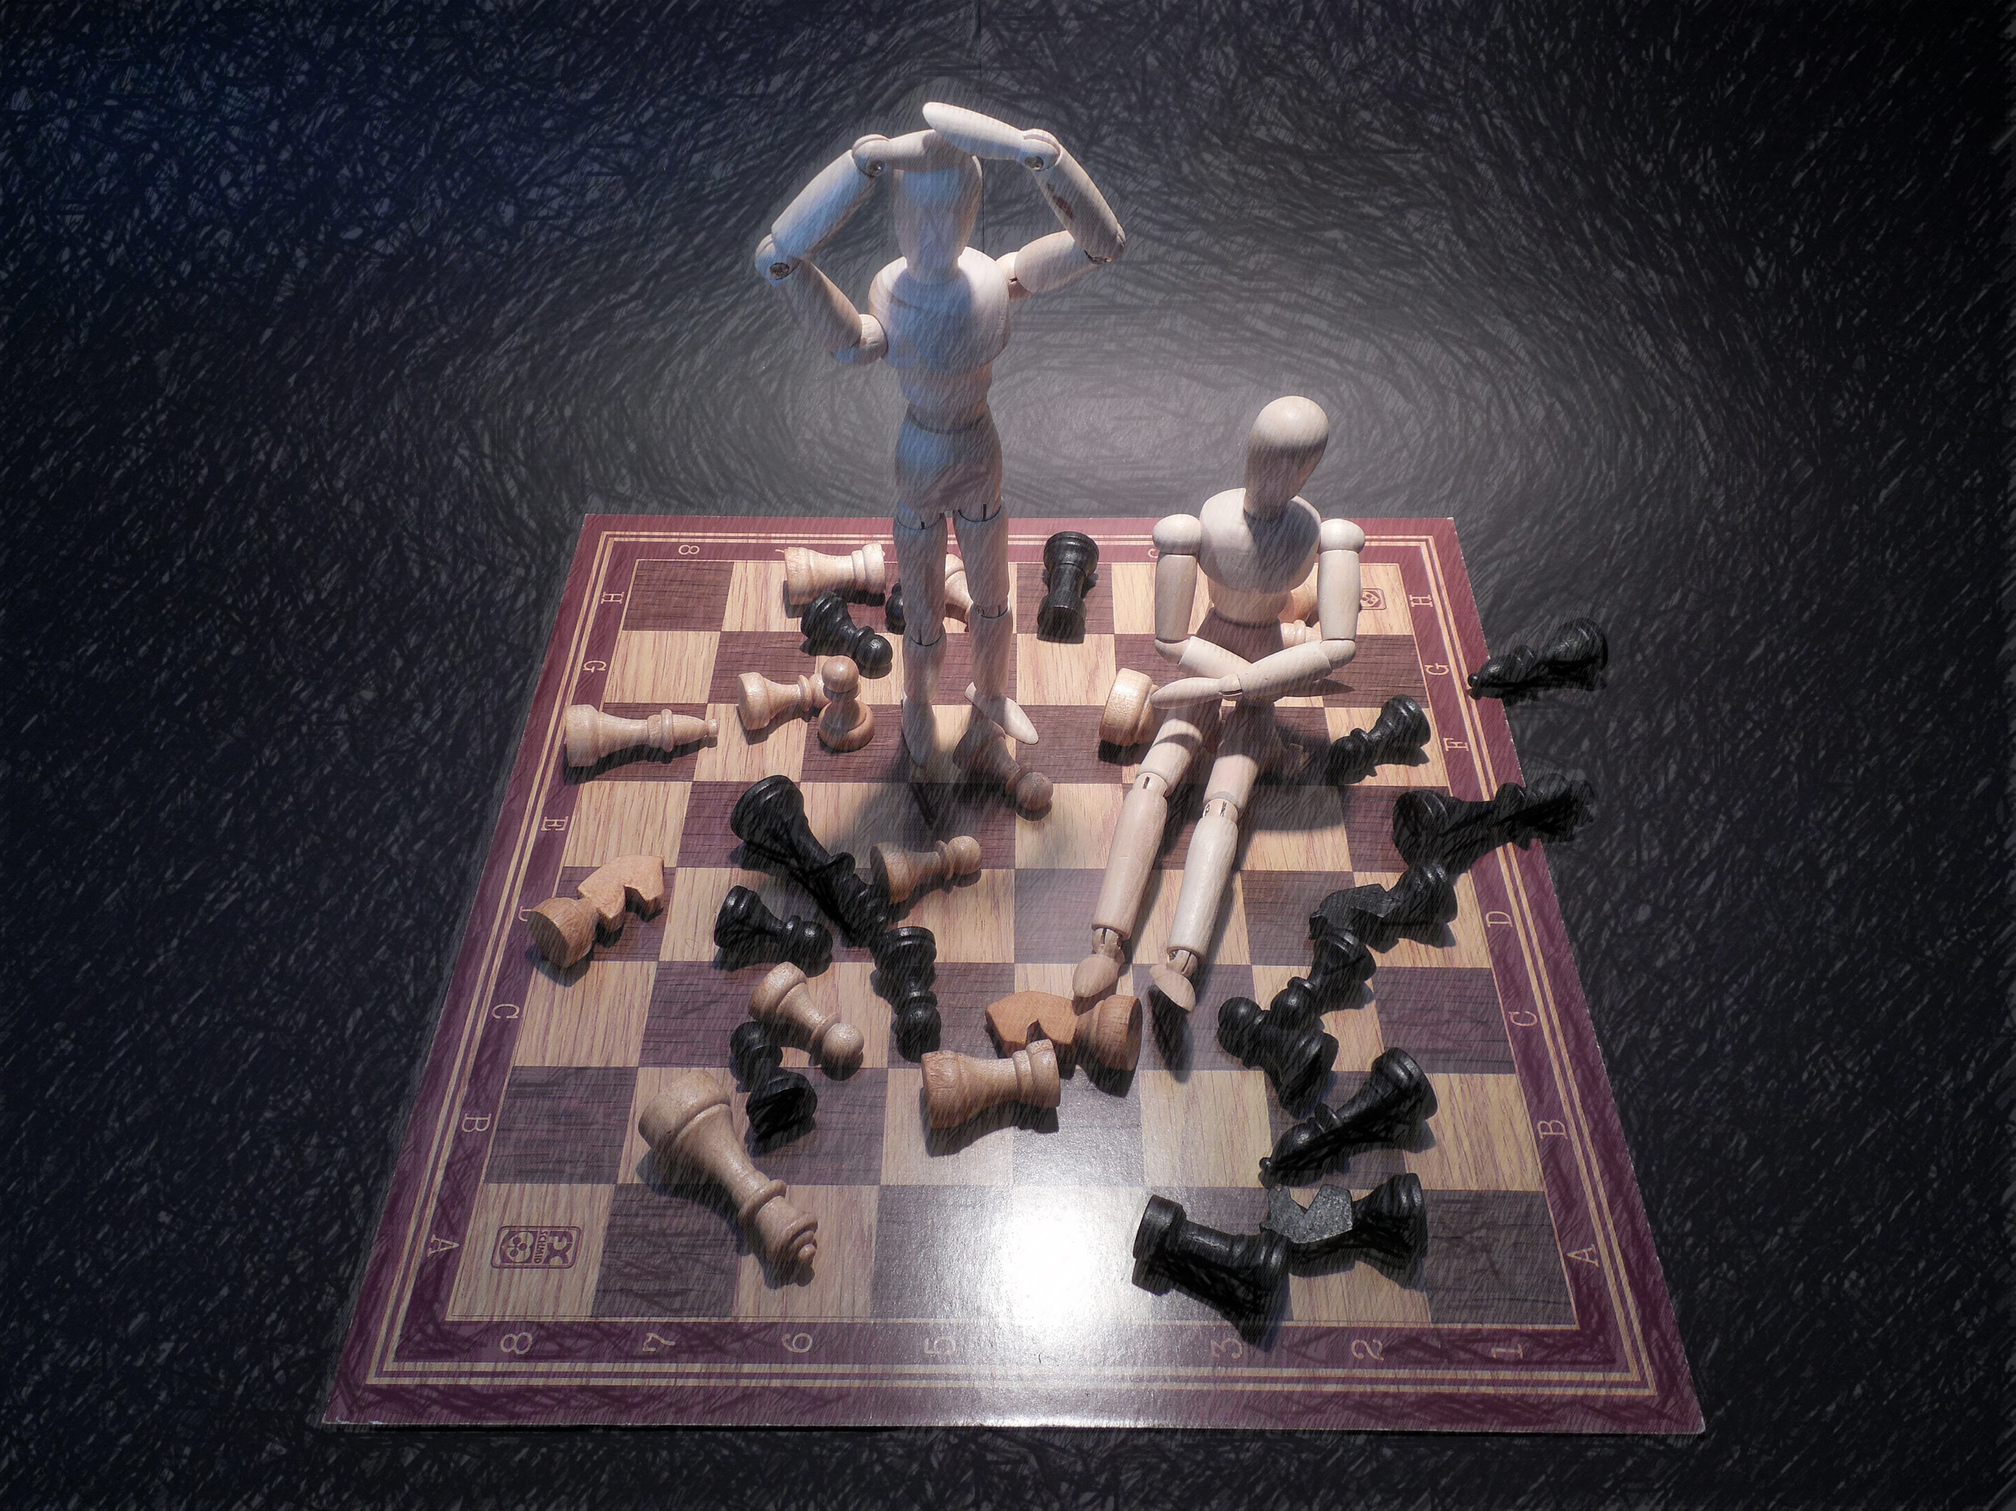
Organizational Crunch
The nature of game development makes estimating how long a task will take difficult, even by experienced developers. What tends not to shift is a project’s deadline, so as a deadline approaches, the practice of crunch can be employed where a team will collectively work longer days as well as weekends in an attempt to finish the necessary work by the deadline.
Sometimes this is a formal process within a company and seen as an expectation, whereas other times developers will simply work the extra time of their own volition. This practice, while common, is criticized because of the heightened risk of burnout, especially when done over an extended period of time.

Slide 22
Avoiding burnout & Crunch Periods
Burnout and Crunch can be mitigated on both personal and organizational levels. Strategies include but are not limited to the following:
Slack time in project planning
Exercise and healthy eating
Flexible work hours to fit team member needs
Breaks between projects
Management ensuring team members are taking time off
Redundancy skill sets between team members to ensure that no employee must remain active for extended periods of times

Slide 23
Conclusion
Questions?

